Slide 1
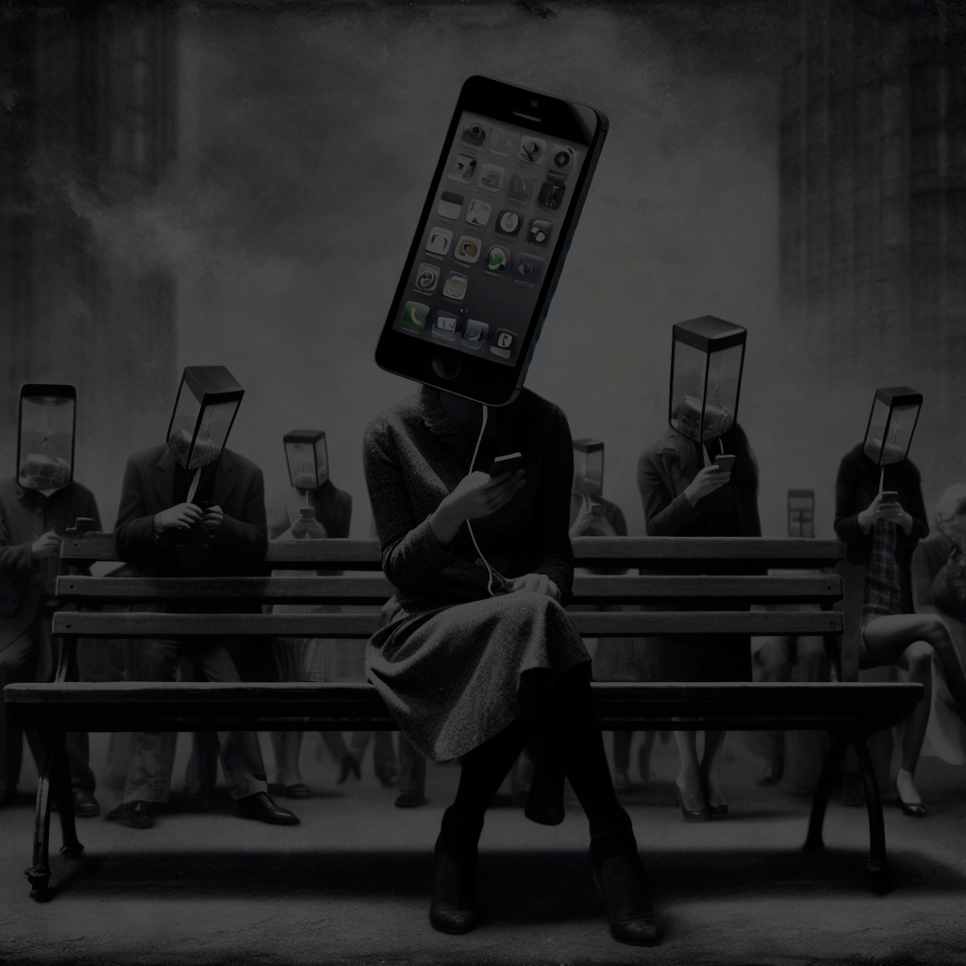

Stop doom scrolling and get into your life: Exploratory assessments of social media use
Albert Malkin

Slide 2
Funding
Western University,
Faculty Research Development Fund

Slide 3
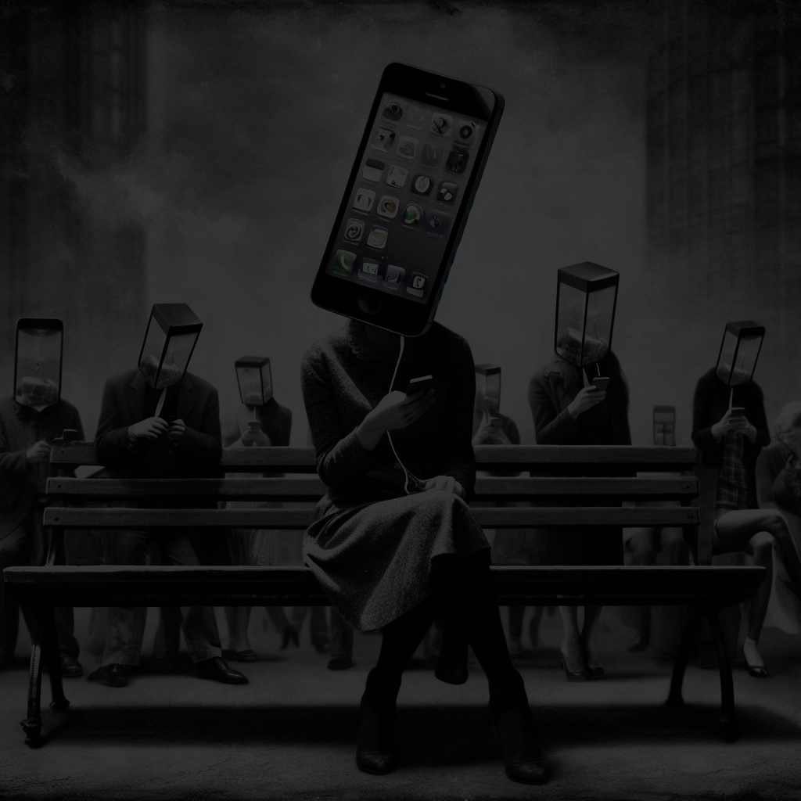
Albert Malkin¹
Collaborators:
Karl F. Gunnarsson^{2,3}, Mark J. Rzeszutek⁴, Aman-Preet Randhawa¹, Erin Walker¹, Kristina Axenova¹, Aly Moscovitz¹ Promise O. Tewogbola⁵, Amy Siebold⁶, Eric A. Jacobs⁵
¹Western Ontario University, Department of Psychology.
²University of Iceland, Department of Physical Therapy.
³Landspitali, The National University Hospital of Iceland.
⁴University of Kentucky, Department of Family and Community Medicine.
⁵Southern Illinois University, Carbondale
⁶I Am Boundless, Inc.

Slide 4
Toward a Functional Assessment of Social Media Use

Slide 5

Notes:
Going to leave this up here for a second. Anyone have the sudden urge to check their phones?
Social media is generally a digital platform or technology that enables individuals and organizations to create, share, and interact with content in the form of text, images, videos, and other media, as well as to connect and communicate with other users. It serves as a virtual space where people can express themselves, exchange information, and engage with others, often in a public or semi-public manner.
The most common form are social networking sites.

Slide 6

Notes:
The most popular are FB with ~3 Billion users
Instrgram has 2.5 billion
Tik tok has 1 billion
The world population is 8 billion! Estimates by the UN are that there are almost 6 billion people over 15. So half of those people are on FB. Or one third OF THE WORLD is on FB.

Slide 7

Notes:
#MeToo (2017-present): The #MeToo movement gained momentum on social media, where survivors of sexual harassment and assault shared their stories, leading to a global conversation about the prevalence of such incidents.

Slide 8

Notes:
2013 - This movement began as a hashtag on Twitter in response to the acquittal of Trayvon Martin's killer. It has since grown into a global movement advocating for racial justice and equality, with social media being a key tool for organizing protests and raising awareness.

Slide 9
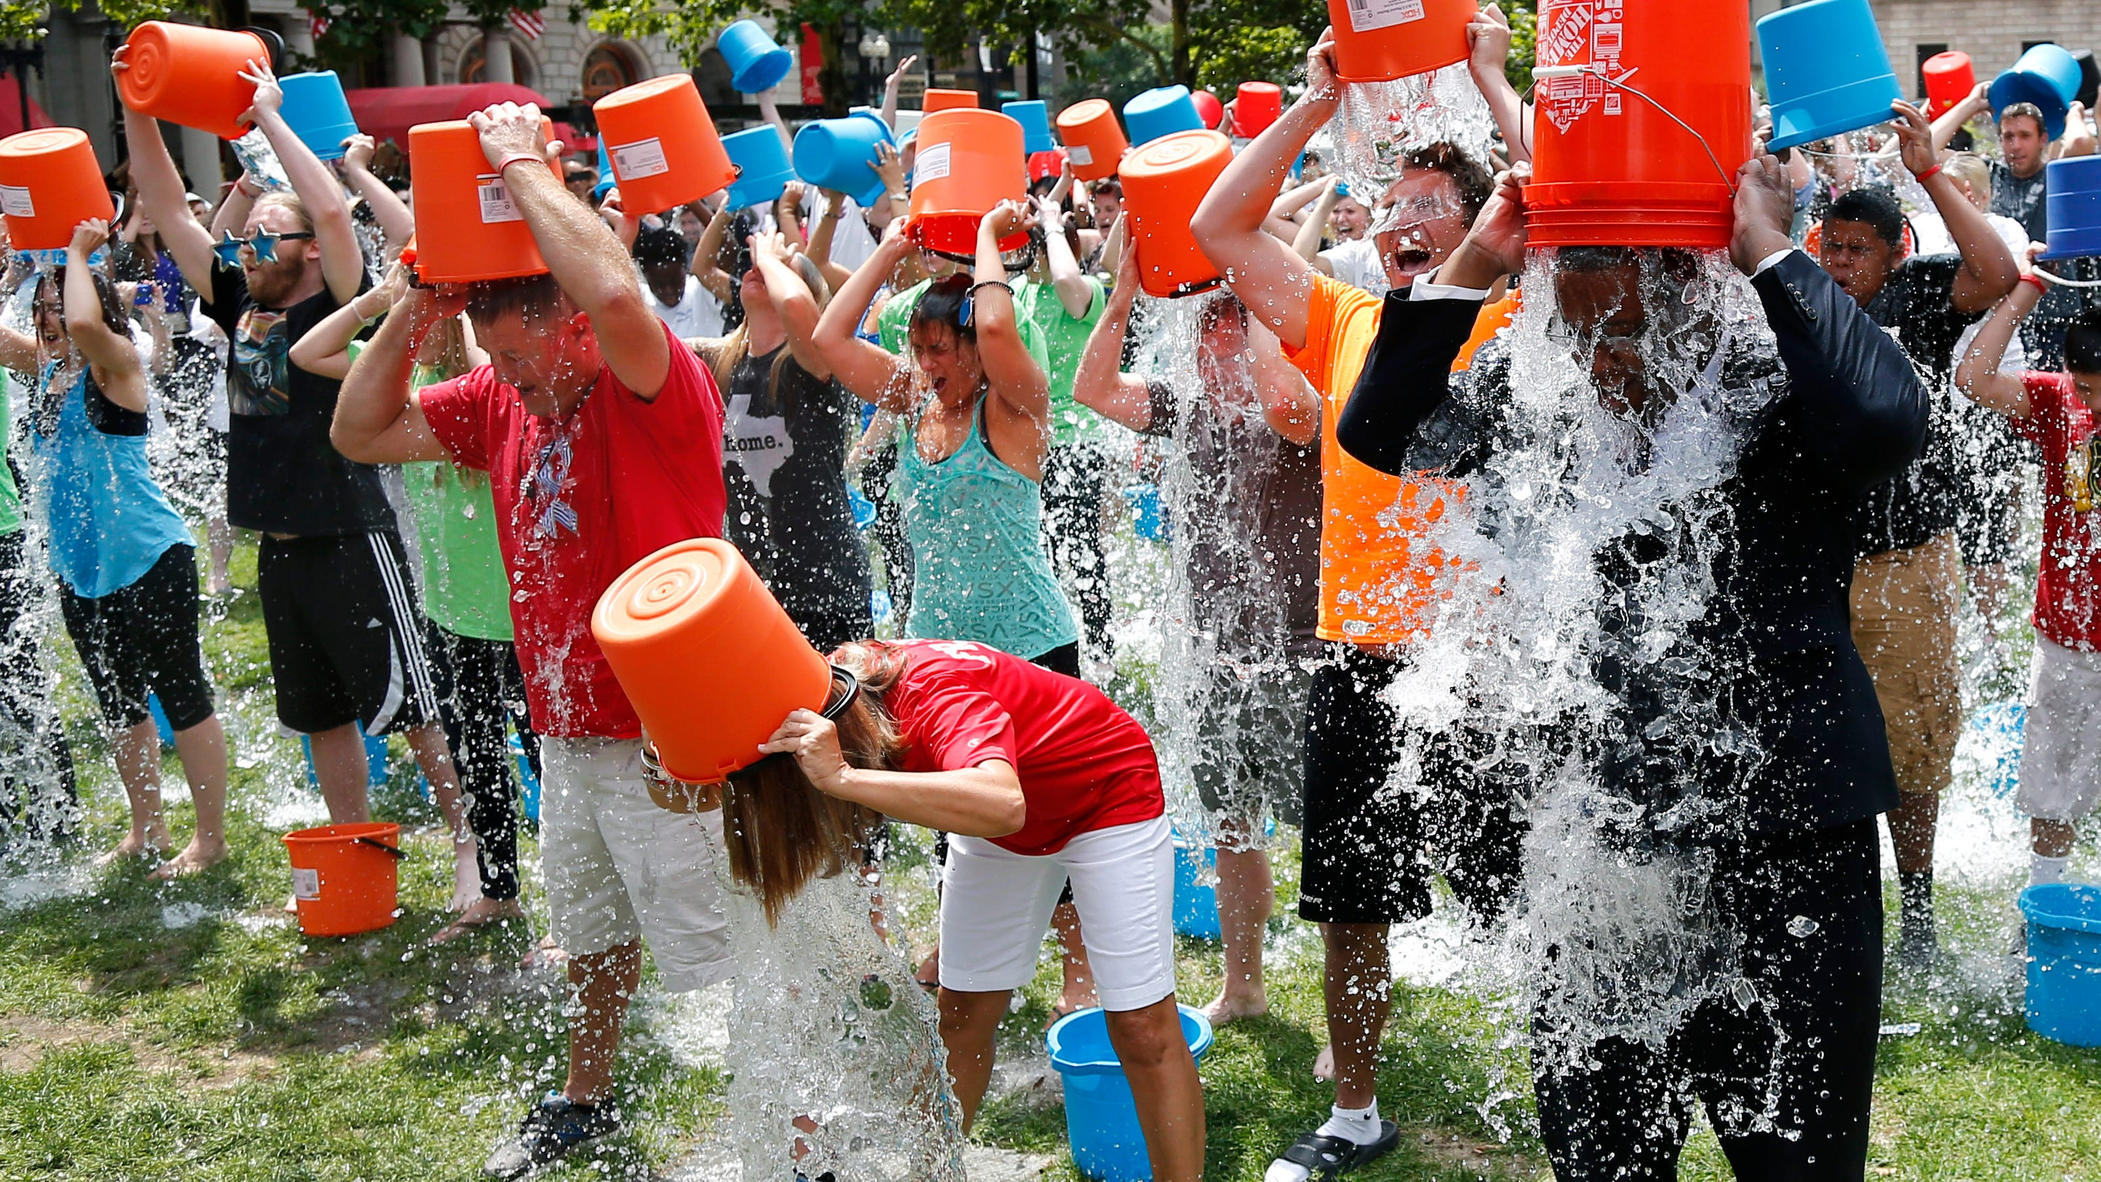
Notes:
Ice Bucket Challenge (2014): This viral campaign raised awareness and funds (which raised over $115M) for (ALS) research. Participants posted videos of themselves getting doused with ice water and encouraged others to do the same

Slide 10

Notes:
BUT social media was also used to organize and galvanize events with less desirable outcomes.

Slide 11
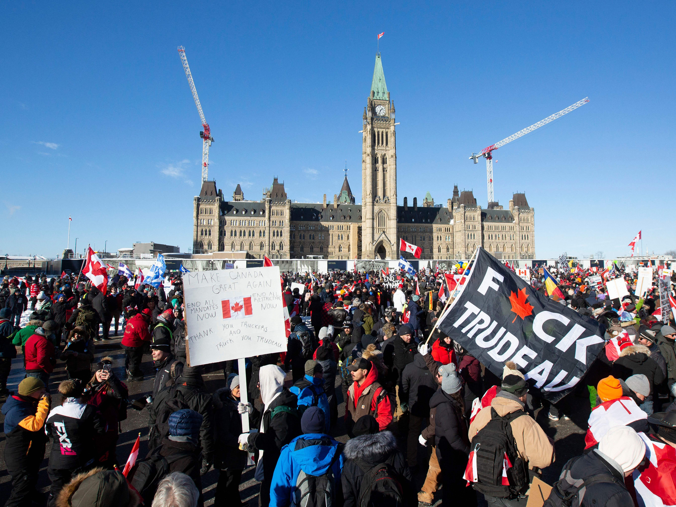
Notes:
Freedom convoy in Ottawa

Slide 12

Notes:
FUTURE
GENERATIONS
Today’s youth face unprecedented physical, mental, and social challenges exacerbated by fast-changing tech.
Social media and artificial intelligence are embedded in kids’ lives as they use technology for everything from education to socializing
Today’s social media platforms are causing significant harm to children and youth. Social media affects attention spans, self-image, and social skills which is leading to increased cyberbullying and depression.

Slide 13

Notes:
ATTENTION &
MENTAL HEALTH
Technology is extracting our attention, weakening our memory, and driving addiction, loneliness, and depression.
While we often use technology because it connects, informs and entertains, there’s clear evidence that it also has serious, negative side effects. These include:
⬆️ Increased anxiety
⬆️ Higher rates of depression
⬆️ More loneliness
⬇️ Lower self-esteem
⬇️ Decreased attention span
⬇️ Less quality sleep

Slide 14

Notes:
INFORMATION
ENVIRONMENT
Misinformation, sensationalism, bad actors, and coordinated bots are destroying our information ecosystem.

Slide 15
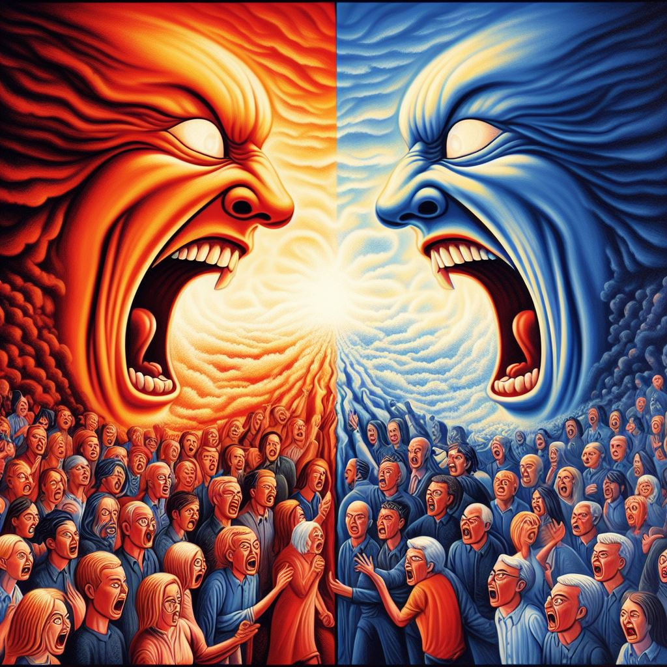
Notes:
DEMOCRATIC
FUNCTIONING
Maximizing engagement amplifies outrage, deepens divisions, and reduces empathy, which is eroding shared consensus.
Due to perverse incentives, social media is weakening global democratic functioning.
Social media platforms – like Facebook, Twitter, Instagram, and TikTok – are financially incentivized to amplify the most engaging content. This leads to an overrepresentation of fake news, disinformation, and divisive content. The cumulative impact on our information environment over the past 10+ years has increased polarization, election interference, legislative lockup, and other manipulative practices that undermine democracies world-wide.

Slide 16

Notes:
PRIVACY &
SAFETY
Our data is exploited by an industry that extracts our attention, shapes our thoughts and overt behaviors, and makes us vulnerable to risks – all for profit.

Slide 17
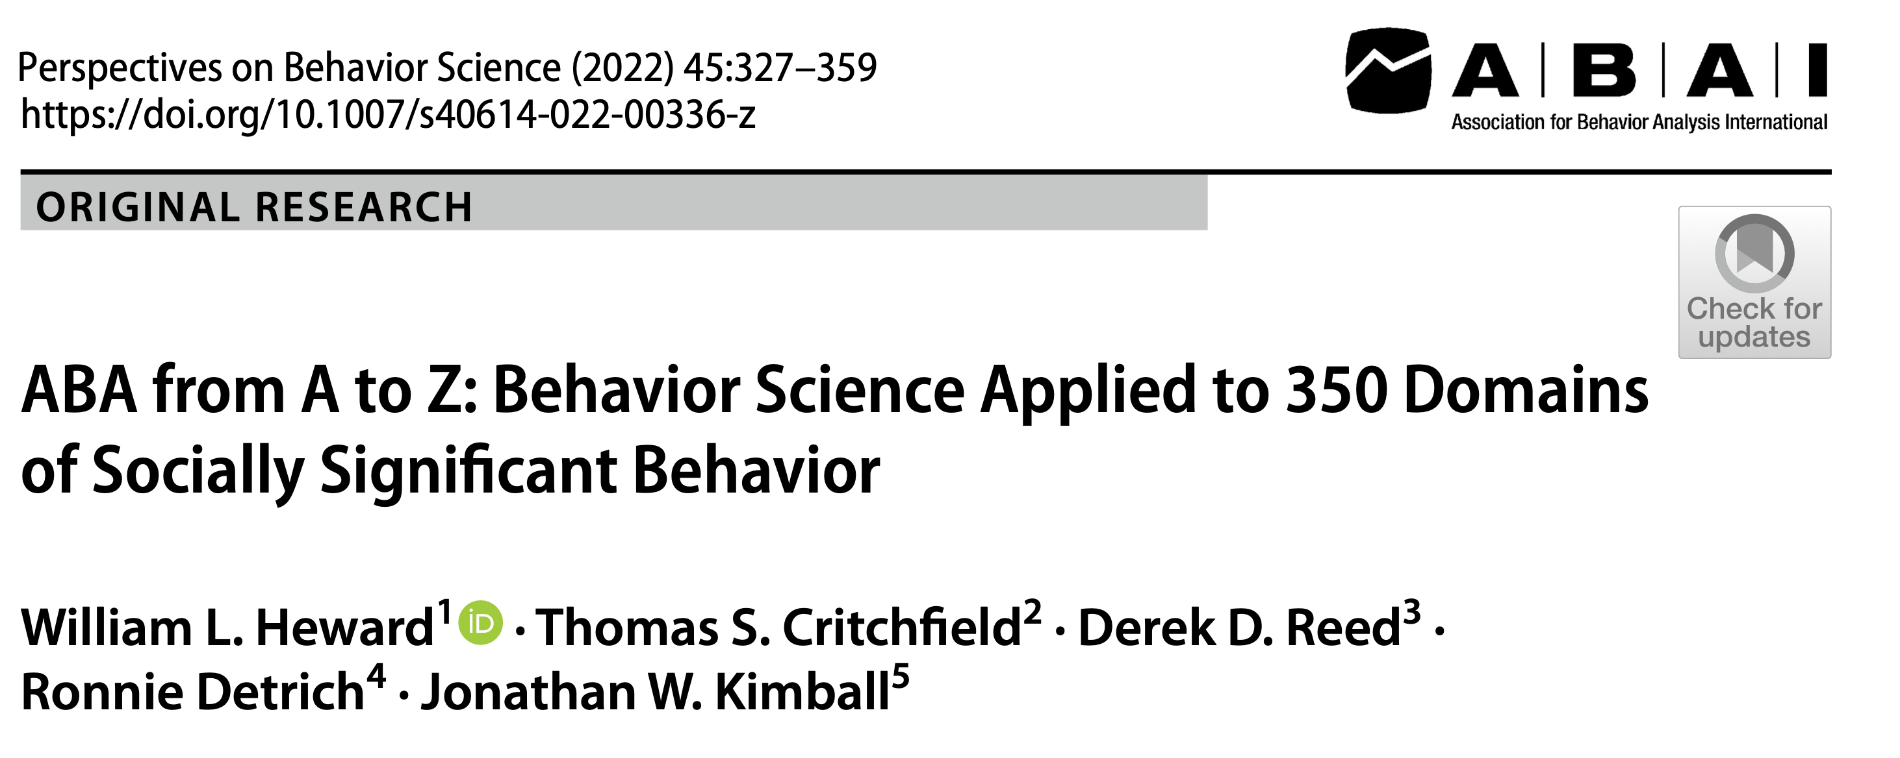
Notes:
“ABA is an expansive field with the potential to meet B.F. Skinner’s original vision of being “a general-purpose science relevant to the entire human experience” (Heward et al., 2022, p. 349).

Slide 18
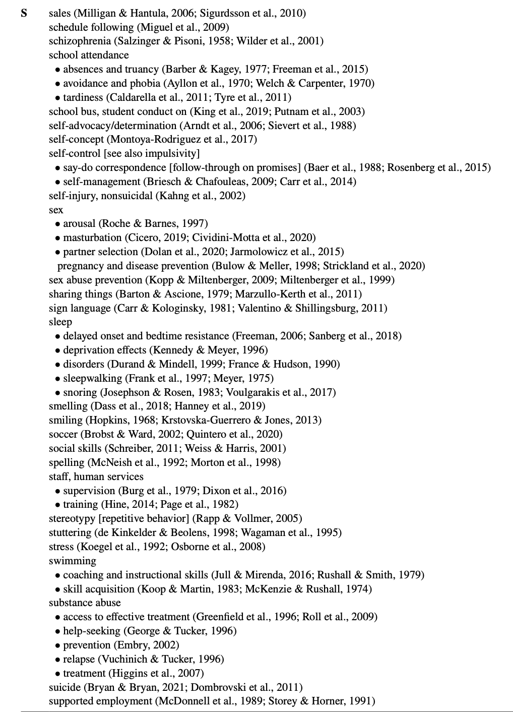

Slide 19
Social Media??
Notes:
Given how prevalent social media use, there is a critical need for increased research attention on excessive or problematic social media usage, to avoid personal and societal harms attributable to online behavior.
Social media use is still a relatively new technology, a gap exists in the state of assessment and treatment using a behavioral framework (Hassan & Kyonka, 2021). We aim to will fill this gap. Importantly, this research program may be scaled to address the growing social issues related to social media use.

Slide 20
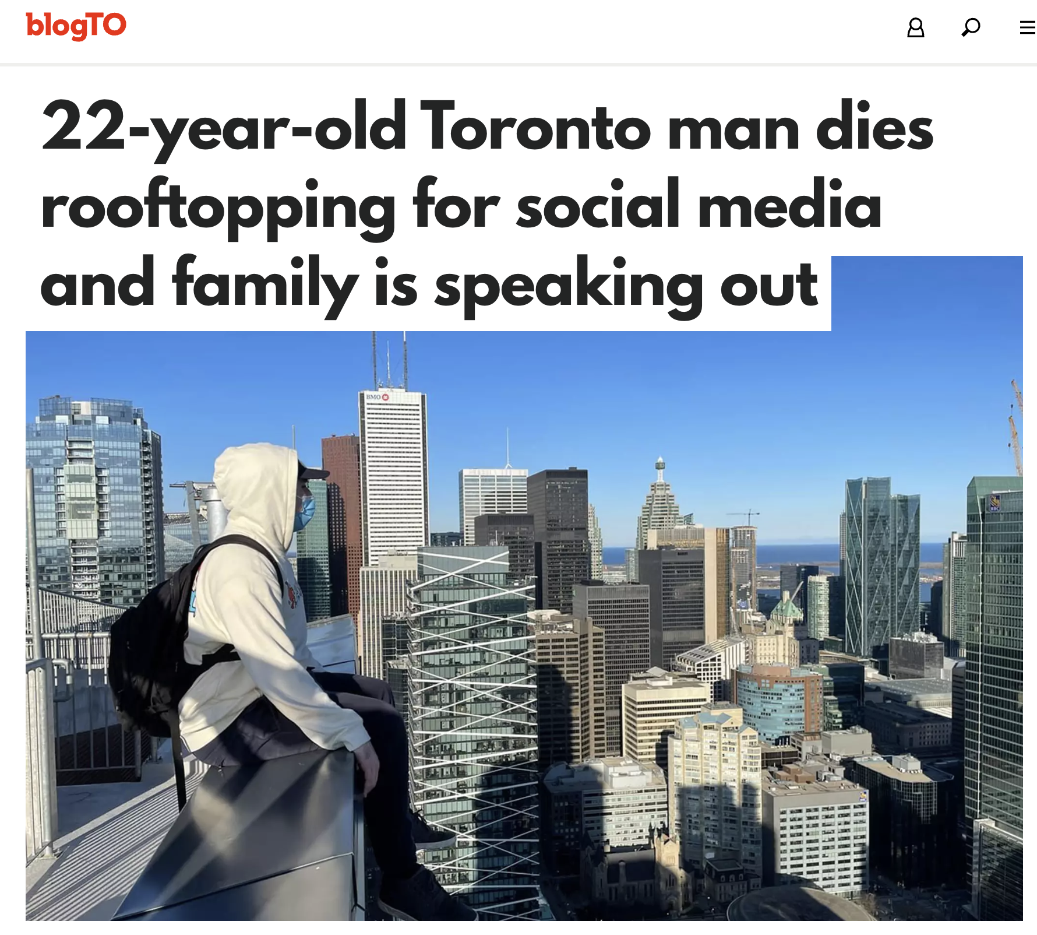
Notes:
To re-cap why we might care. While some social media use is just fine. OR some of you people might lose a little sleep because you’re scrolling through your feed looking for the next juicy picture of someone else's cute puppy. Or because you had to have the last word in some argument. Others might not be able to stop themselves and get seriously hurt.
The list of what can only be described as dumb and dangerous things people do online is far too long. But plenty of young people have been seriously injured or died.
People have been:
Tide Pod Challenge: This challenge involved people filming themselves eating Tide laundry detergent pods, which can be toxic and even deadly¹.
Cinnamon Challenge: This challenge involved people trying to swallow a spoonful of cinnamon without drinking water, which can cause choking and respiratory problems¹.
Choking Game: This game involves people intentionally choking themselves or others to achieve a brief high, which can lead to brain damage or death¹.

Slide 21
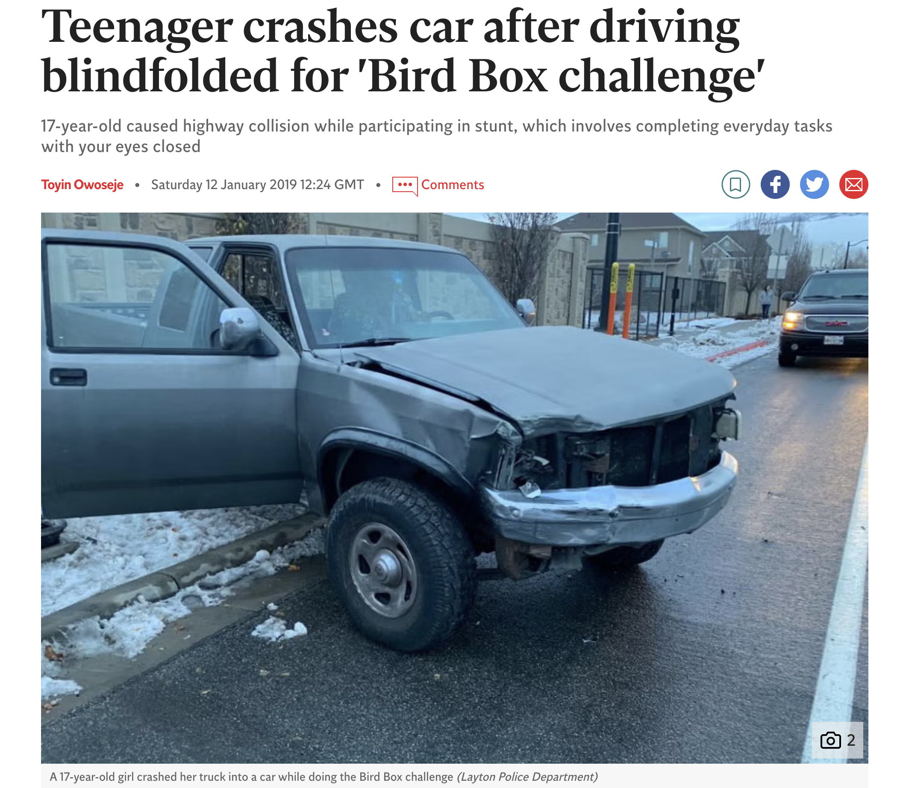
Notes:
These kinds of incidents make me wonder If there’s something that could be done to step in cases where people are at risk.
Perhaps this might be a role behavior analysts can play. But what can we do?

Slide 22
To provide a behavioral framework for social media use, this study assessed the validity of the Social Media Use Functional Assessment
(SMUFA; Malkin et al., 2021).
Notes:
We sought to validate our new assessment's convergent validity and construct validity.

Slide 23
Participants included 372 students undergraduate and graduate students
Notes:
Data retained for factor analyses, score lower than .5 in RelevantID fraud score, and incomplete responses removed n = 372 from 447.
$10.00 Amazon gift card as compensation

Slide 24
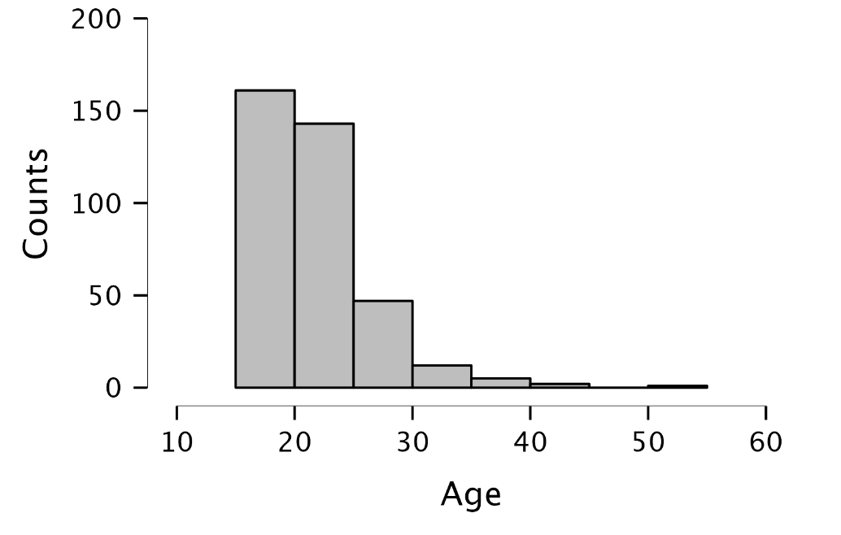
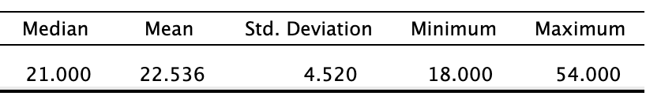
Notes:
Descriptive Statistics
Median Mean Std. Deviation Minimum Maximum Age 21.000 22.536 4.520 18.000 54.000

Slide 25
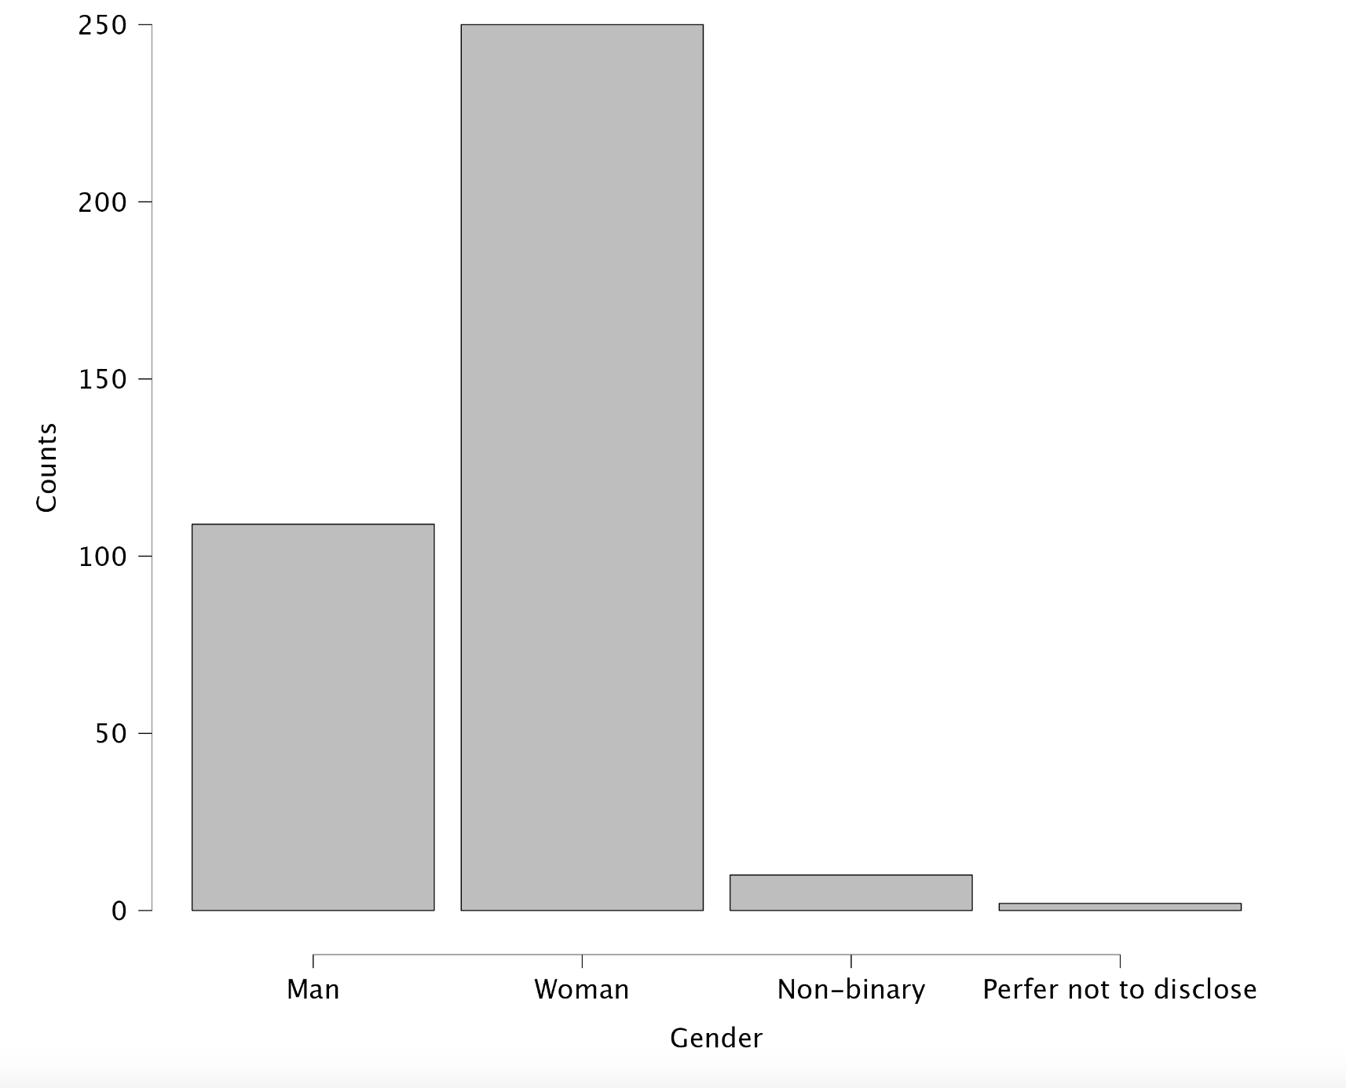
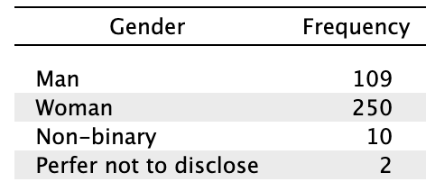
Notes:
Frequencies for Gender
Male109
Woman 250
Non-binary
Perfer not to disclose

Slide 26
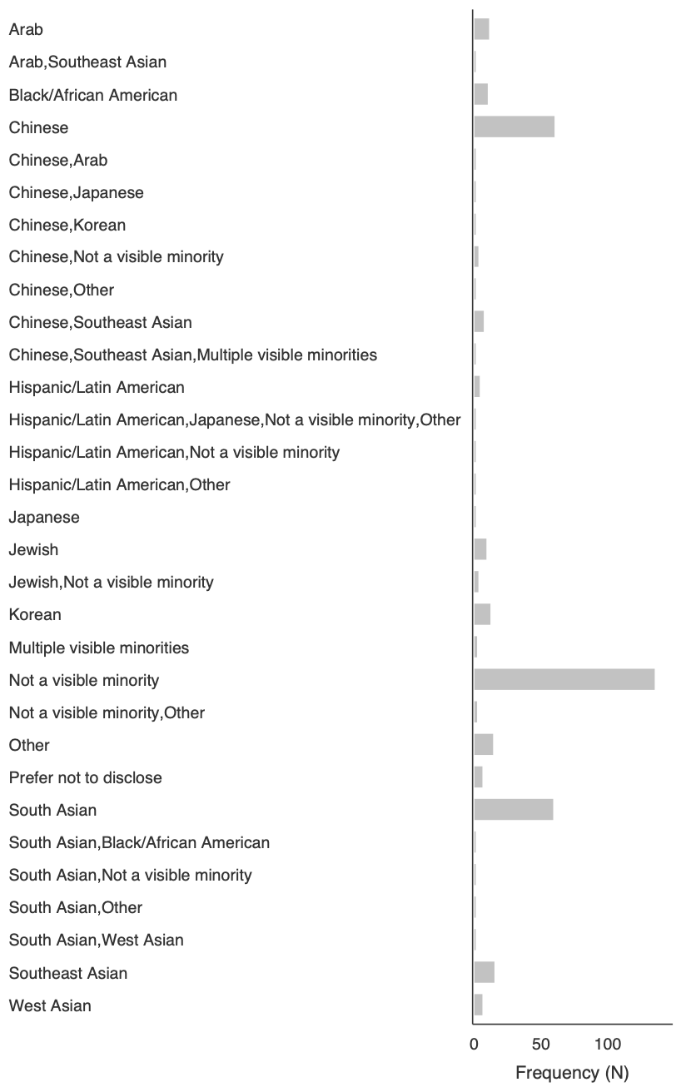

Slide 28
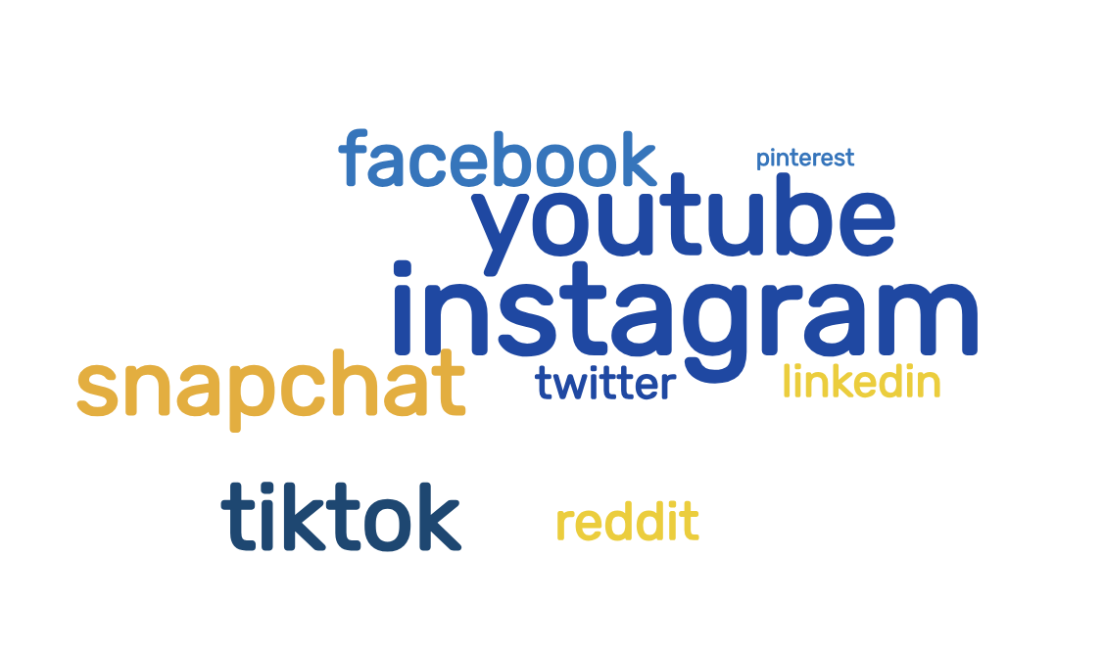
Notes:
Which apps do you use the most (check all that apply)?

Slide 29
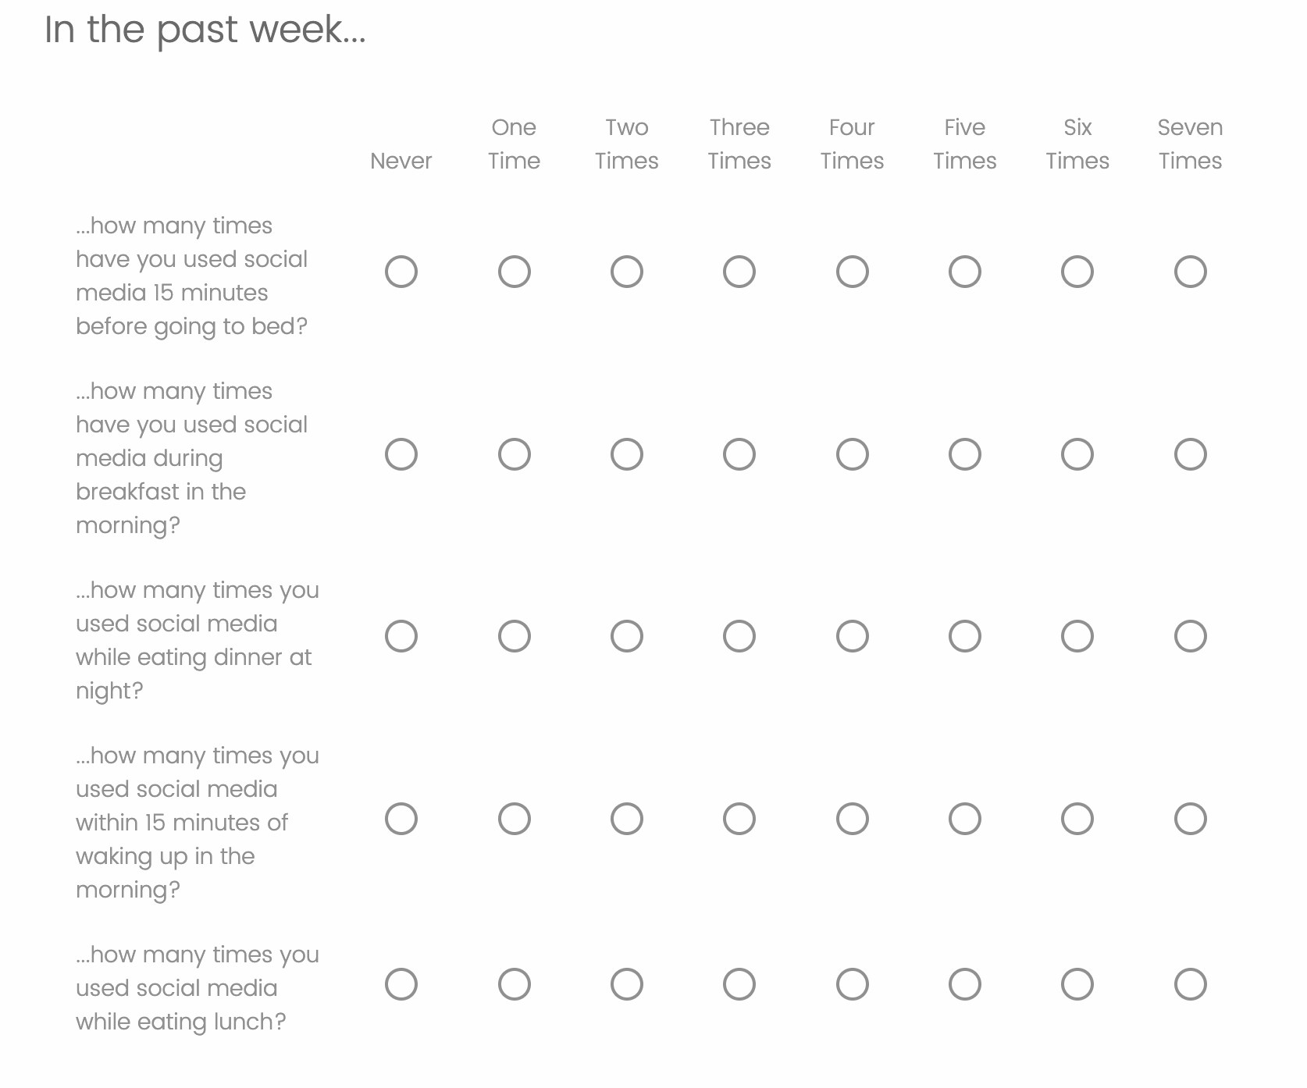
Social Media Engagement Questionnaire (SMEQ)
Przybylski, et al. (2013)
Notes:
This questionnaire aimed at examining how social media was a part of everyday routines

Slide 30
Social Media Engagement Questionnaire (SMEQ)
Przybylski, et al. (2013)
Notes:
This questionnaire aimed at examining how social media was a part of everyday routines

Slide 31
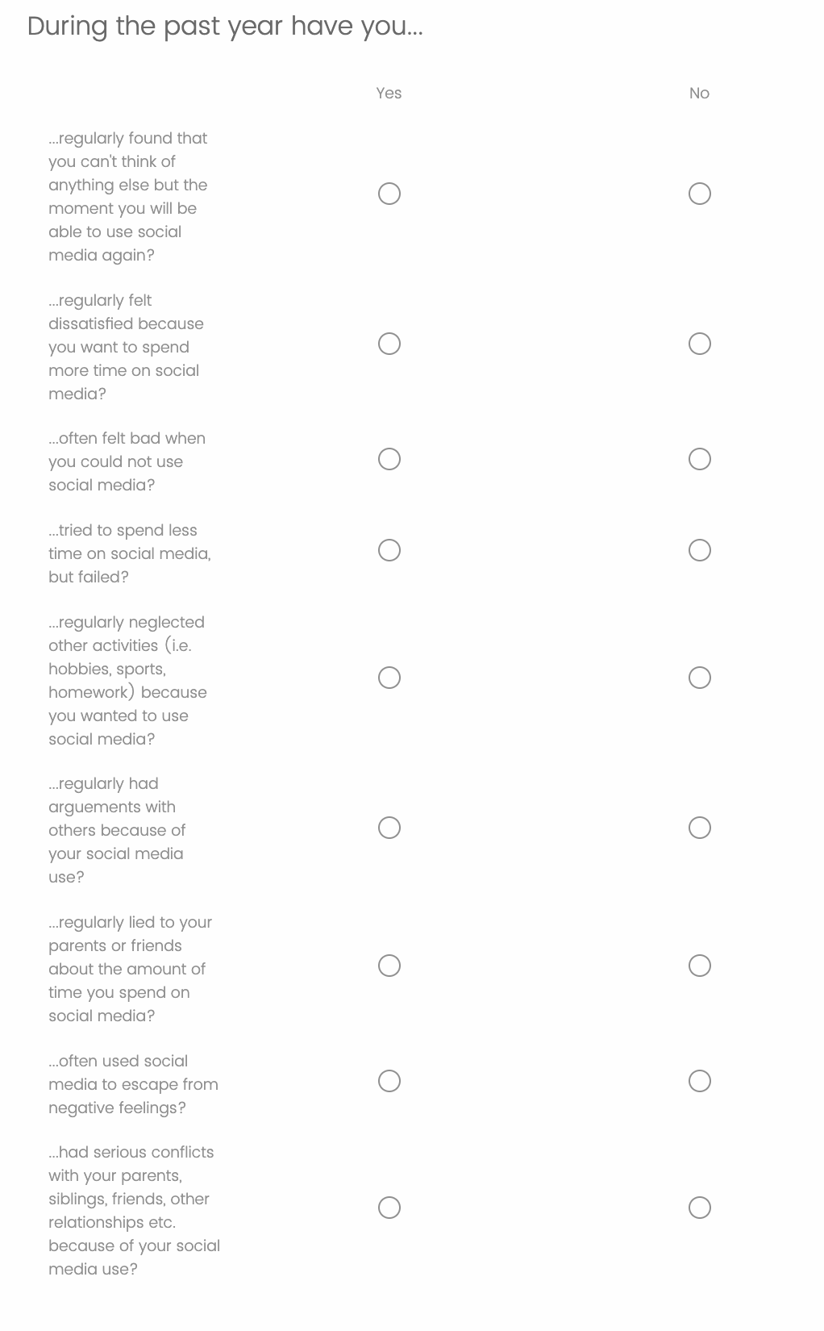
Social Media Disorder Scale
Eijinen, et al. (2016)
Notes:
This questionnaire approached social media more from an addiction framework

Slide 32
Social Media Disorder Scale
Eijinen, et al. (2016)

Slide 33
Social Media Disorder Scale
Eijinen, et al. (2016)

Slide 34
Bergen Social Media Addiction Scale
Andreassen, et al. (2016)

Slide 35
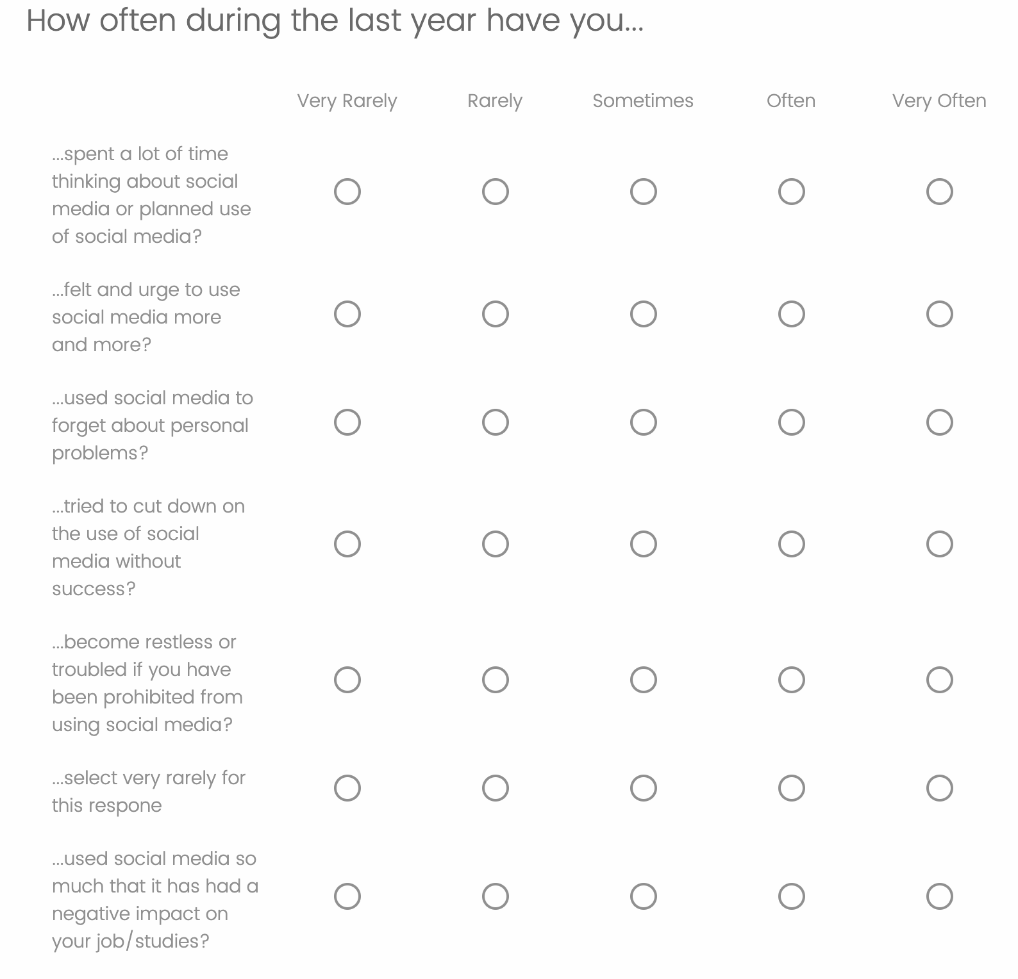
Bergen Social Media Addiction Scale
Andreassen, et al. (2016)
Notes:
Same with this one. It’s similar addiction-like scale

Slide 36
Bergen Social Media Addiction Scale
Andreassen, et al. (2016)
Notes:
Same with this one. It’s similar addiction-like scale

Slide 37
Bergen Social Media Addiction Scale
Andreassen, et al. (2016)
Notes:
Same with this one. It’s similar addiction-like scale

Slide 38
Bergen Social Media Addiction Scale
Andreassen, et al. (2016)
Notes:
Same with this one. It’s similar addiction-like scale

Slide 39
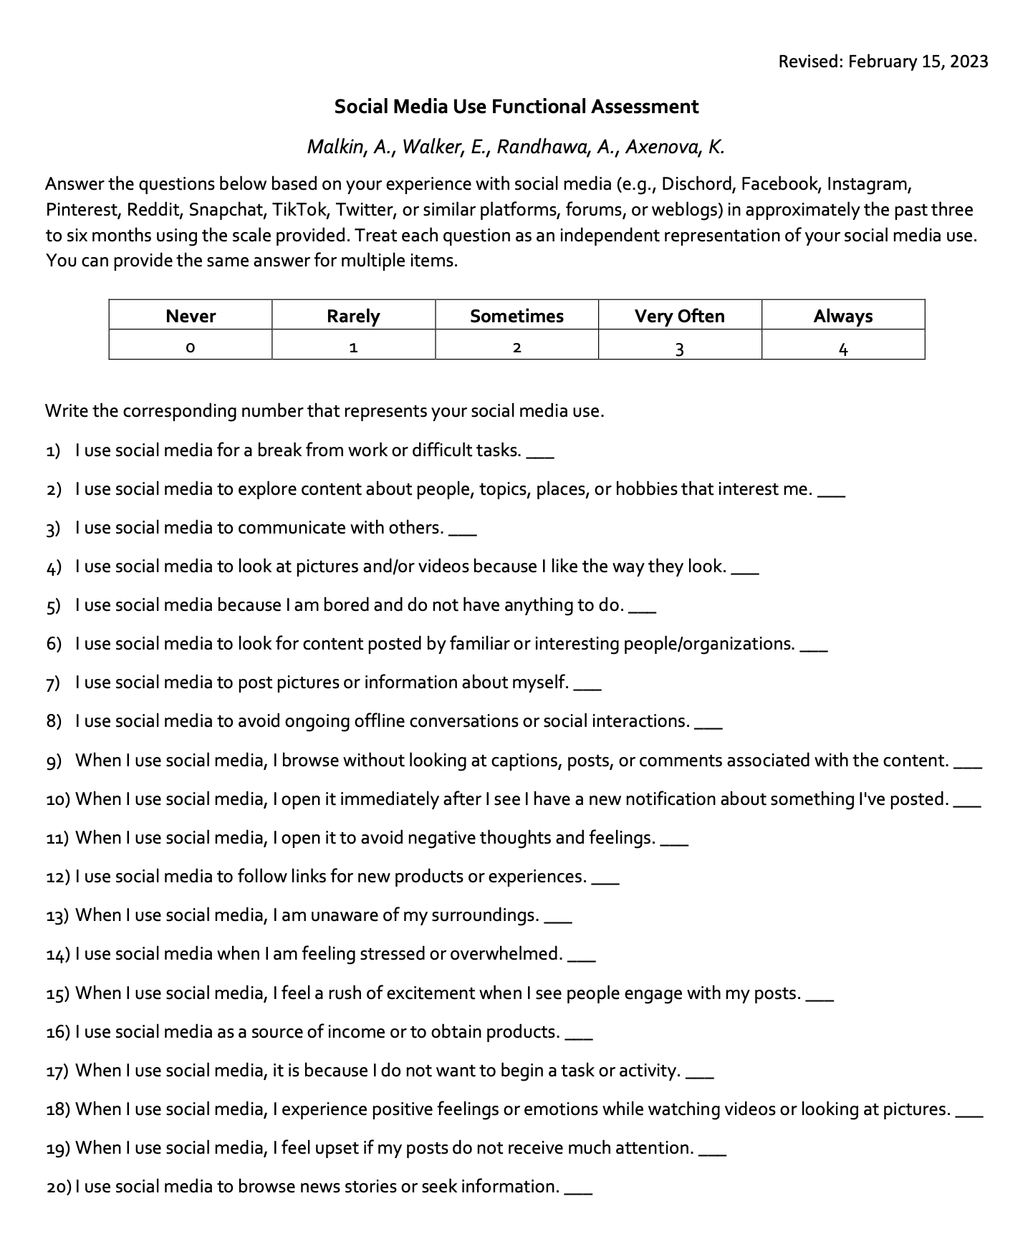

Slide 40
Preliminary

Slide 45
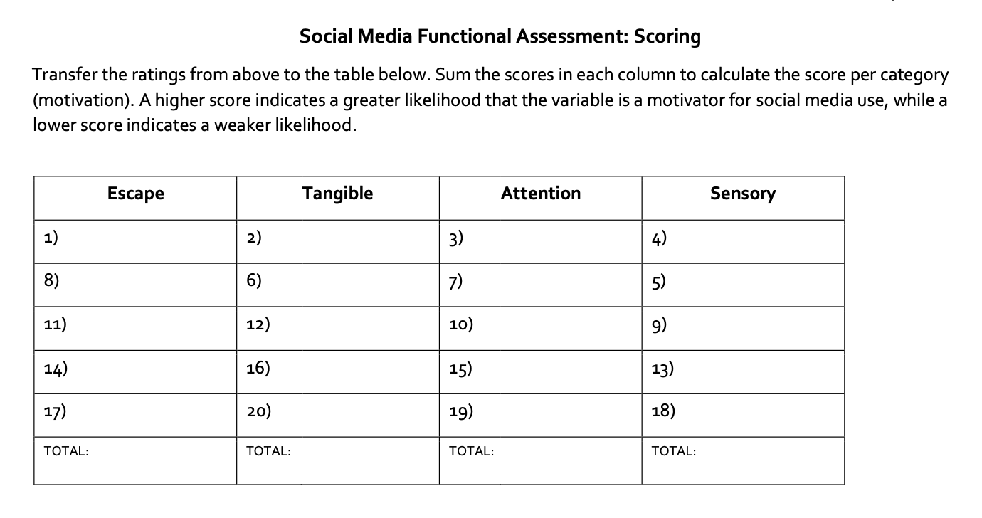

Slide 46
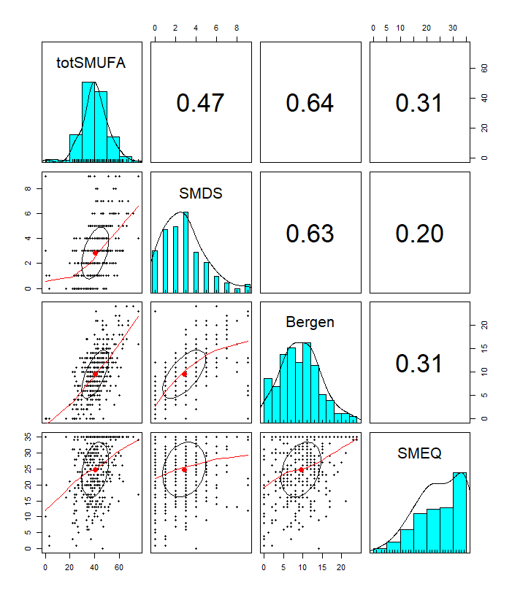

Slide 50
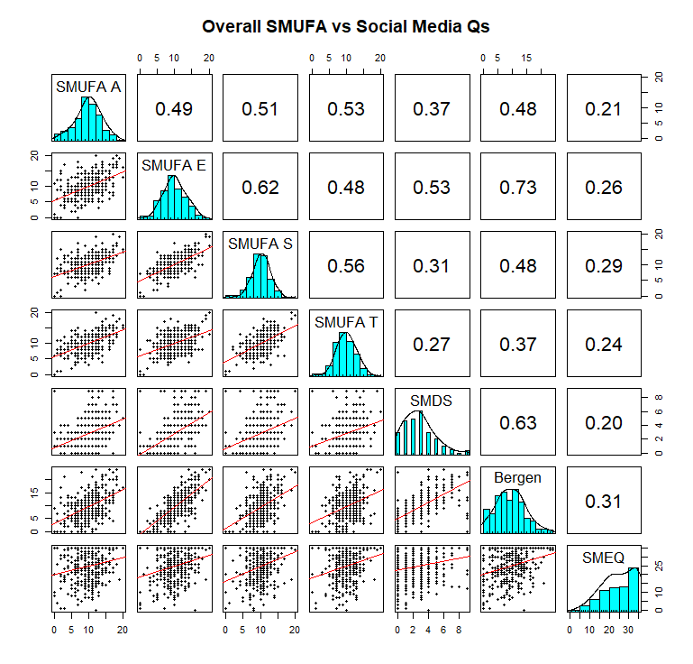
Notes:
The SMUFA escape subscore was most strongly related to the BSMS and SMDS, whereas the SMEQ (past week use) had the weakest relationship to SMUFA scores as well as the BSMS and SMDS. Overall SMUFA scores also were most related to the BSMS.

Slide 51
Notes:
The SMUFA escape subscore was most strongly related to the BSMS and SMDS (both ask about the past year use)
whereas the SMEQ (past week use) had the weakest relationship to SMUFA
scores as well as the BSMS and SMDS. Overall SMUFA scores also were most related to the BSMS.

Slide 52
Notes:
The SMUFA escape subscore was most strongly related to the BSMS and SMDS (both ask about the past year use)
whereas the SMEQ (past week use) had the weakest relationship to SMUFA
scores as well as the BSMS and SMDS. Overall SMUFA scores also were most related to the BSMS.

Slide 53
Notes:
The SMUFA escape subscore was most strongly related to the BSMS and SMDS (both ask about the past year use)
whereas the SMEQ (past week use) had the weakest relationship to SMUFA
scores as well as the BSMS and SMDS. Overall SMUFA scores also were most related to the BSMS.

Slide 54
Notes:
The SMUFA escape subscore was most strongly related to the BSMS and SMDS (both ask about the past year use)
whereas the SMEQ (past week use) had the weakest relationship to SMUFA
scores as well as the BSMS and SMDS. Overall SMUFA scores also were most related to the BSMS.

Slide 55
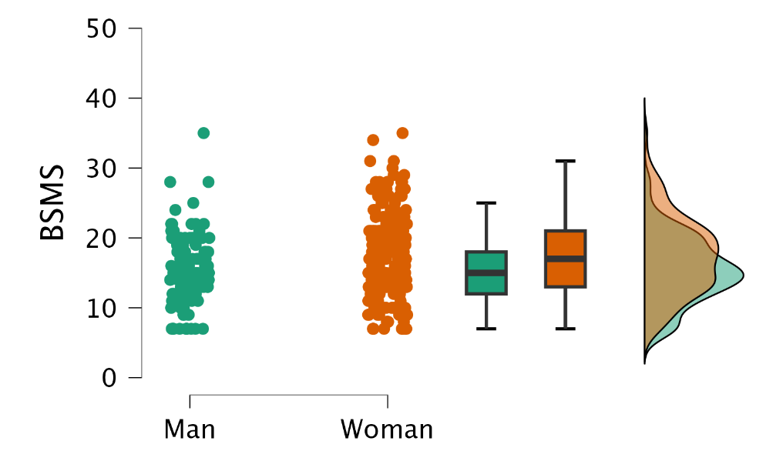
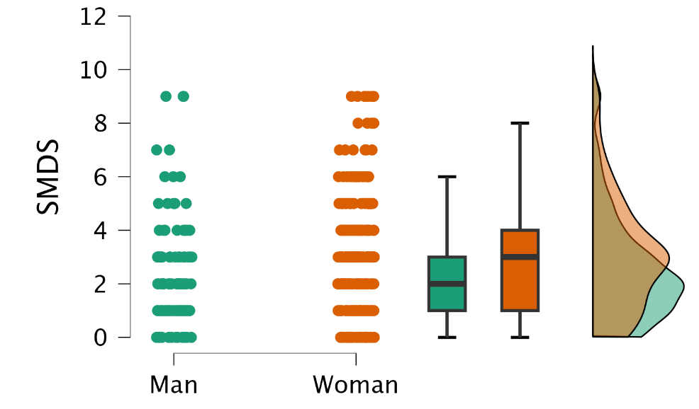
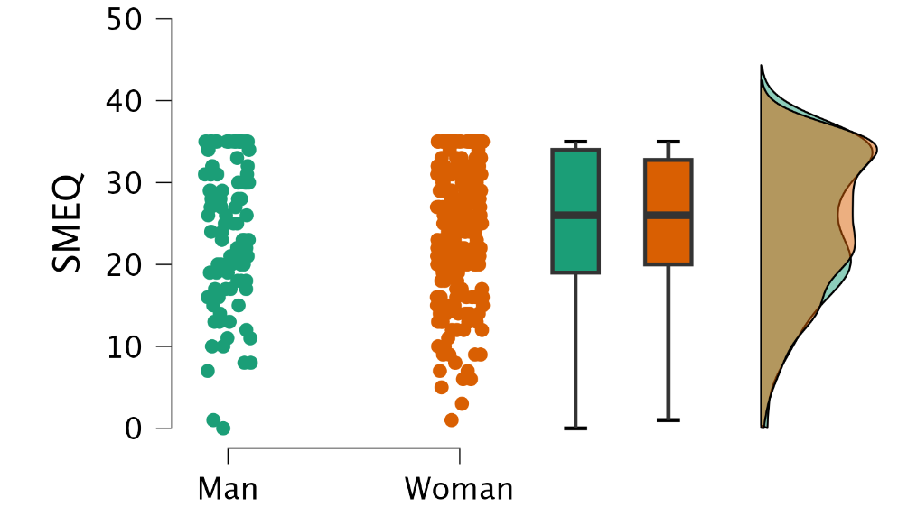
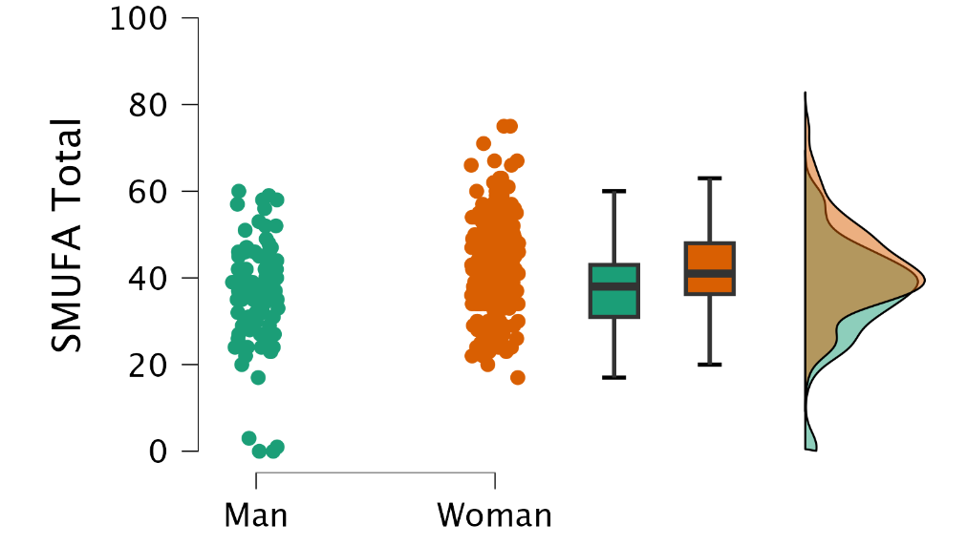

Slide 62
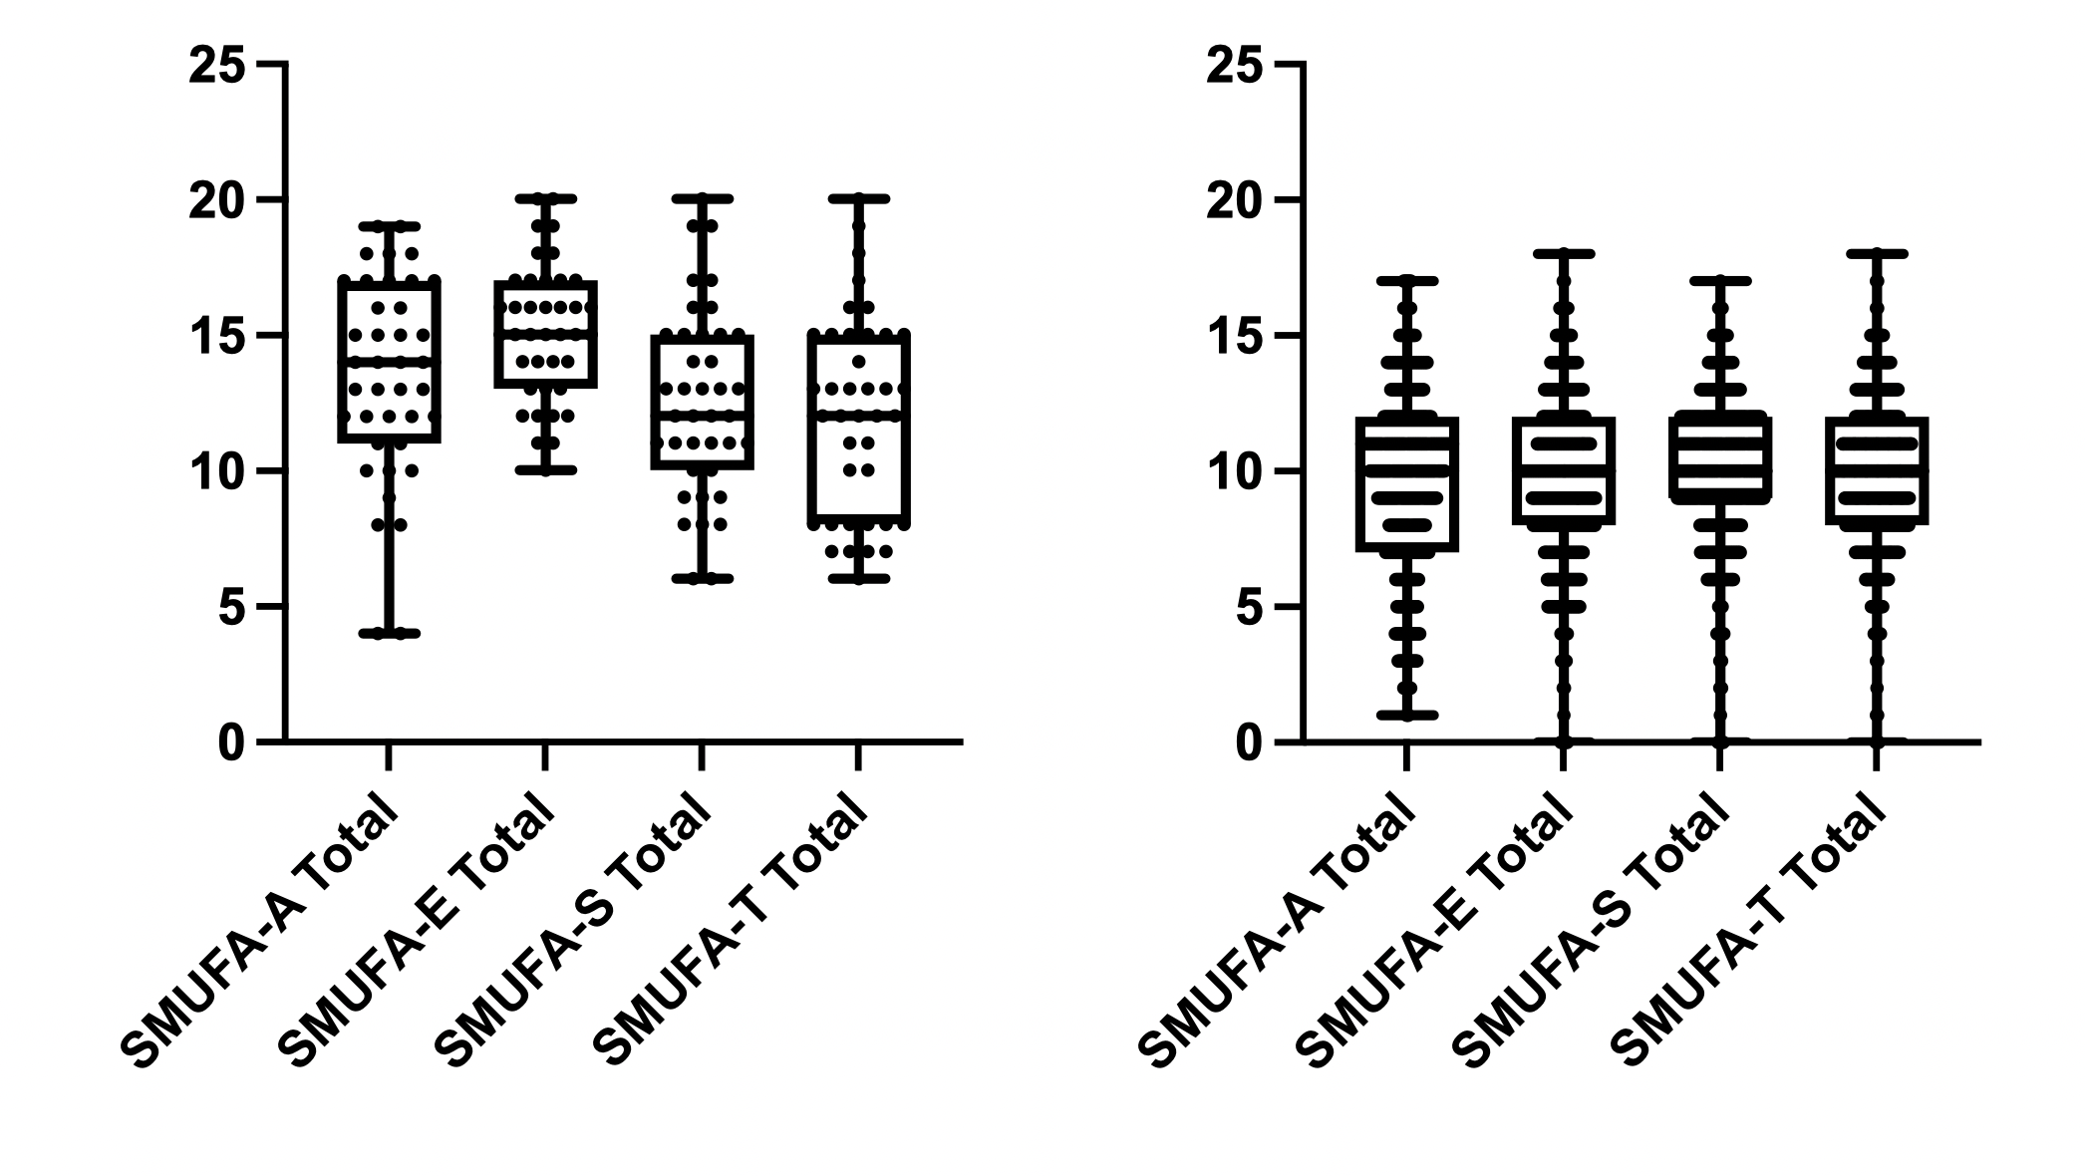
Above Cutoff on BSMAS
Below Cutoff on BSMAS

Slide 63
Above Cutoff on BSMAS
Below Cutoff on BSMAS

Slide 64
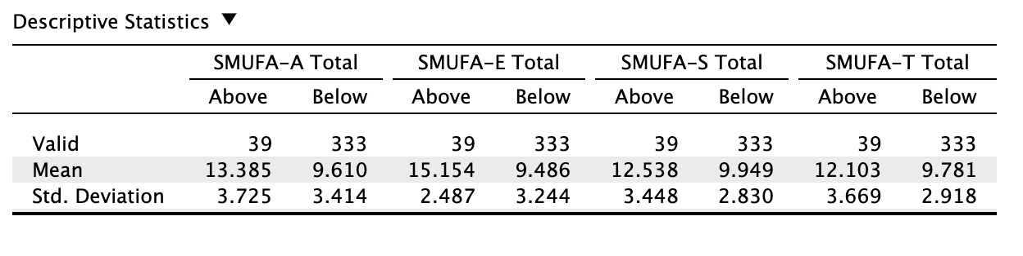

Slide 65
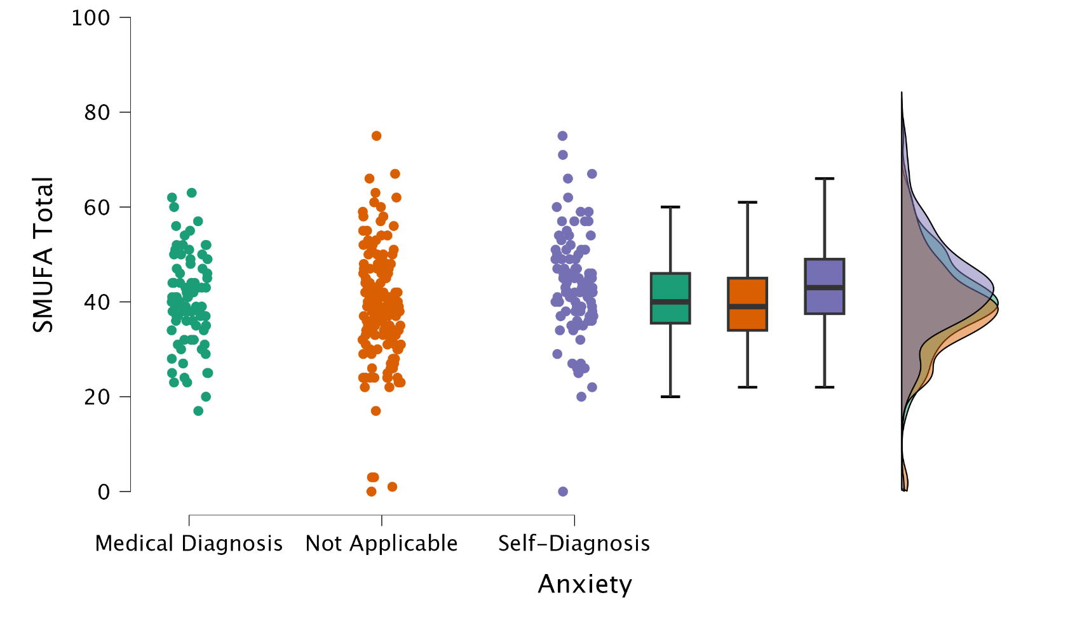

Slide 67
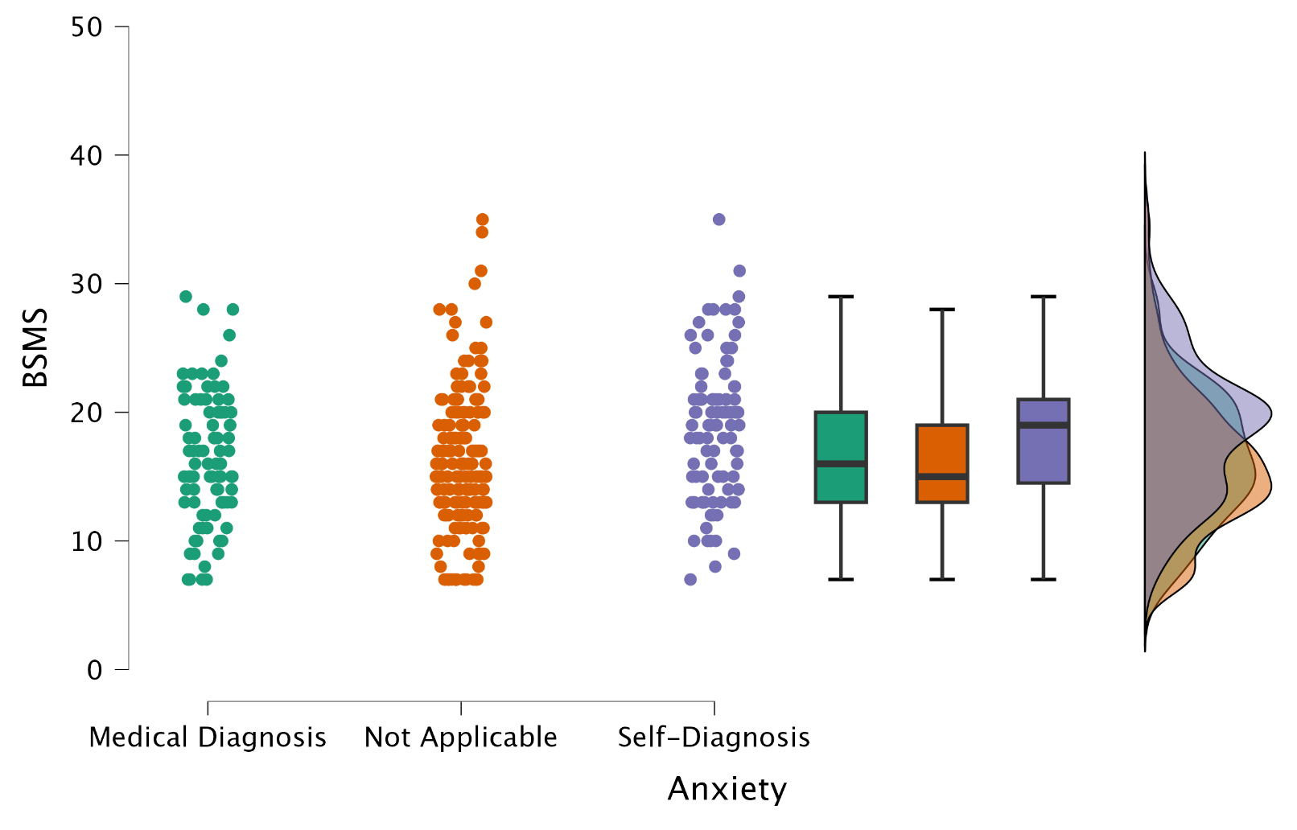

Slide 69
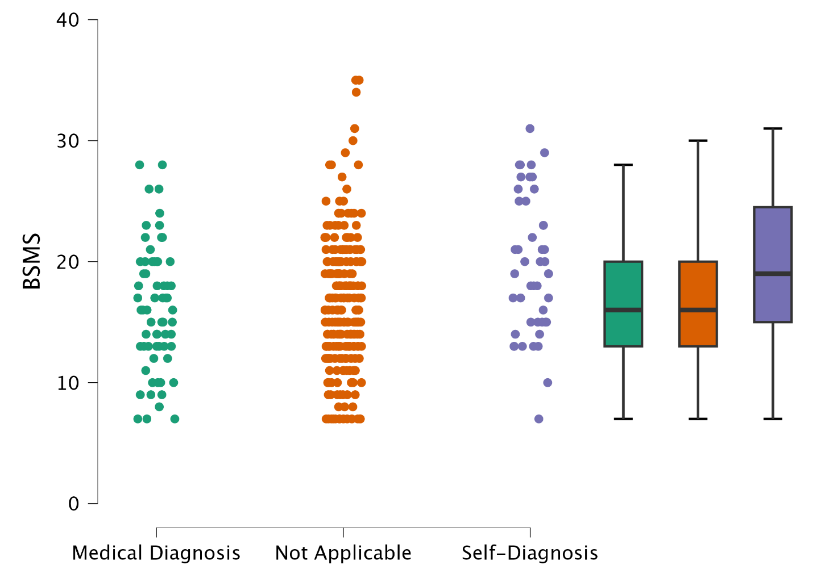
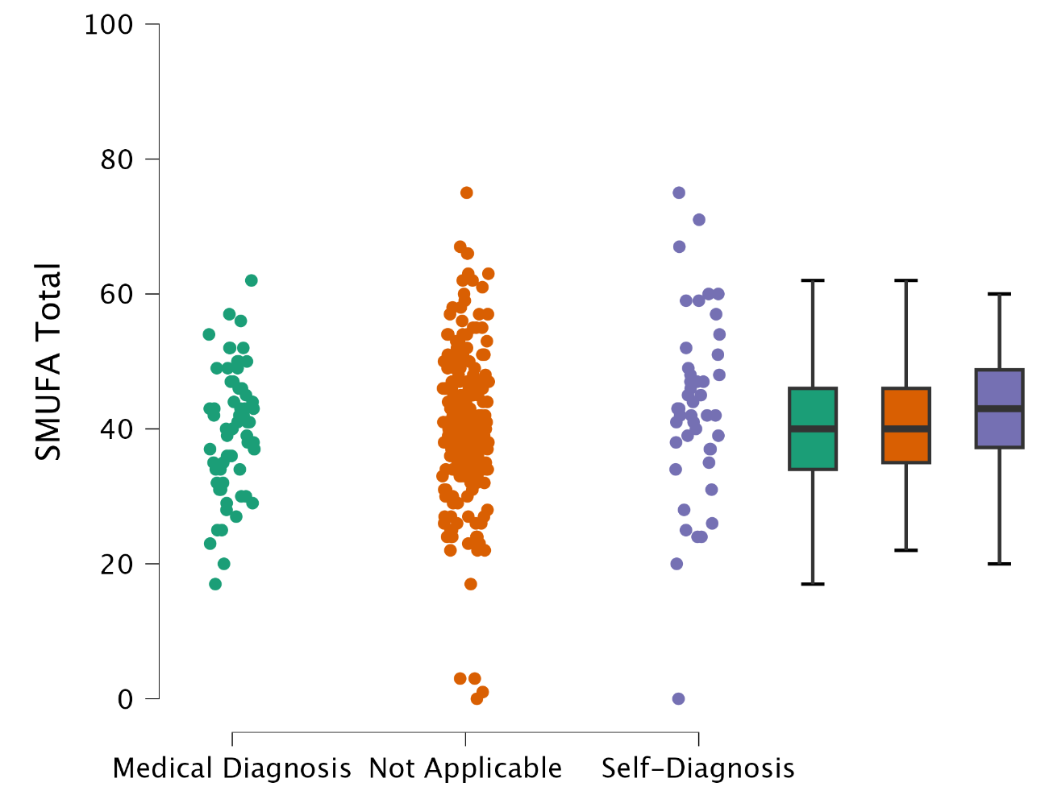
Depression
Notes:
BSMS has Statistical sig. but SMUFA has a similar pattern

Slide 70
Depression
Notes:
BSMS has Statistical sig. but SMUFA has a similar pattern

Slide 71
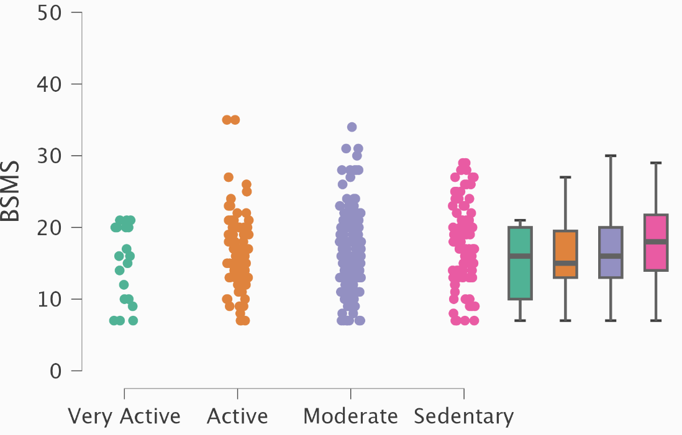
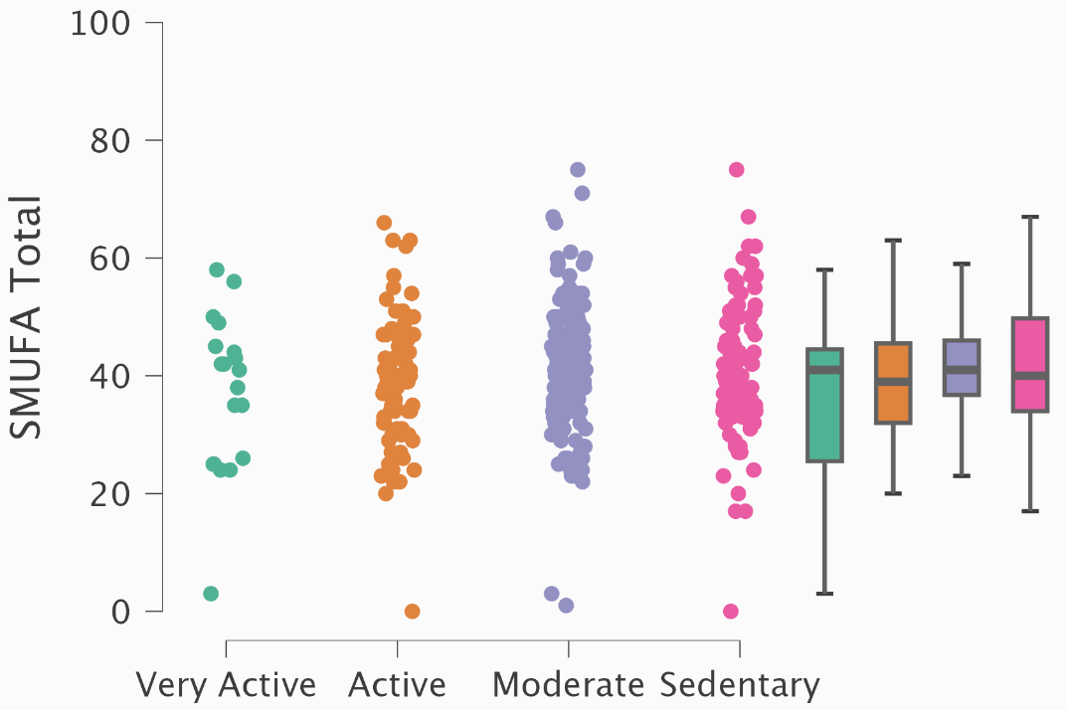
Weekly level of movement and exercise
Notes:
Not sig. but there’s a trend

Slide 72
Weekly level of movement and exercise
Notes:
Not sig. but there’s a trend

Slide 73
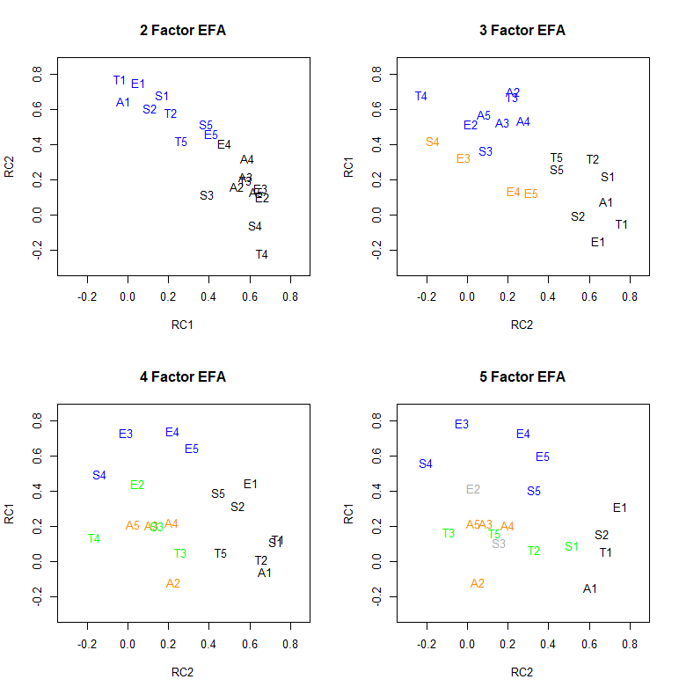
Notes:
Running an EFA, using different rotations,

Slide 74
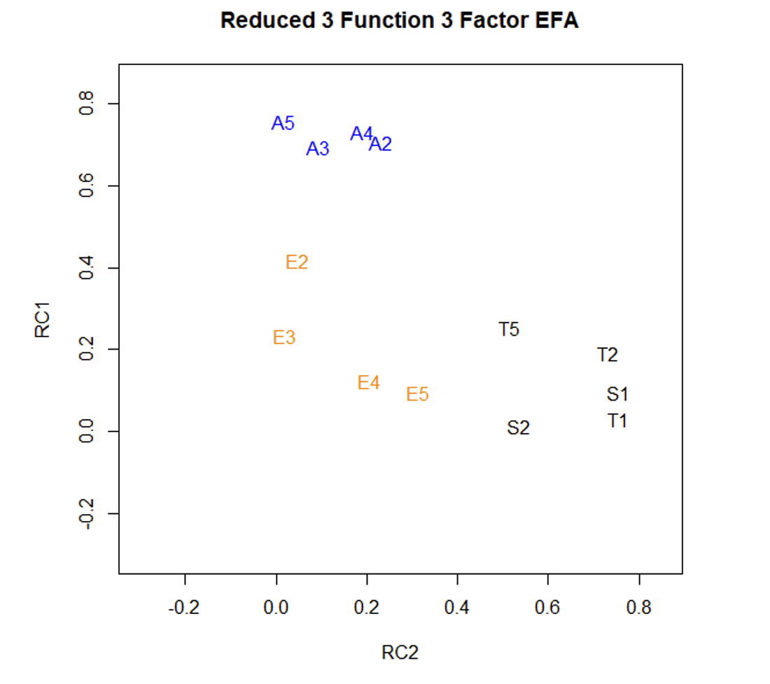

Slide 75
Notes:
After reducing the number of questions and factors, a three factor model (i.e., Attention, Escape, Tangible/Sensory) identified a good fit (RMSEA = .068).
Following question and factor reduction, a three-factor solution loaded questions E2-5 on factor 3, A2-5 on factor 2, and T1,2,5/S1,2 on factor 1. As a preliminary investigation, it appears that social media may be maintained by specific environmental consequences but may not neatly align with a “four function” view of behavior. Syntheses between certain “functions” may be warranted for further development of the SMUFA.

Slide 76
Escape | Tangible/Sensory |  | Attention
I use social media to avoid ongoing offline conversations or social interactions. | I use social media to explore content about people, topics, places, or hobbies that interest me. | I use social media to post pictures or information about myself.
When I use social media, I open it to avoid negative thoughts and feelings. | I use social media to look for content posted by familiar or interesting people/organizations. | When I use social media, I open it immediately after I see I have a new notification about something I've posted.
I use social media when I am feeling stressed or overwhelmed. | I use social media to browse news stories or seek information. | When I use social media, I feel a rush of excitement when I see people engage with my posts.
When I use social media, it is because I do not want to begin a task or activity. | I use social media to look at pictures and/or videos because I like the way they look. | When I use social media, I feel upset if my posts do not receive much attention.
 | I use social media because I am bored and do not have anything to do.
Notes:
20 items reduced to 13 items, described 3 pertinent functions

Slide 77
Escape | Tangible/Sensory |  | Attention
I use social media to avoid ongoing offline conversations or social interactions. | I use social media to explore content about people, topics, places, or hobbies that interest me. | I use social media to post pictures or information about myself.
When I use social media, I open it to avoid negative thoughts and feelings. | I use social media to look for content posted by familiar or interesting people/organizations. | When I use social media, I open it immediately after I see I have a new notification about something I've posted.
I use social media when I am feeling stressed or overwhelmed. | I use social media to browse news stories or seek information. | When I use social media, I feel a rush of excitement when I see people engage with my posts.
When I use social media, it is because I do not want to begin a task or activity. | I use social media to look at pictures and/or videos because I like the way they look. | When I use social media, I feel upset if my posts do not receive much attention.
 | I use social media because I am bored and do not have anything to do.
Notes:
20 items reduced to 13 items, described 3 pertinent functions

Slide 78
Escape | Tangible/Sensory |  | Attention
I use social media to avoid ongoing offline conversations or social interactions. | I use social media to explore content about people, topics, places, or hobbies that interest me. | I use social media to post pictures or information about myself.
When I use social media, I open it to avoid negative thoughts and feelings. | I use social media to look for content posted by familiar or interesting people/organizations. | When I use social media, I open it immediately after I see I have a new notification about something I've posted.
I use social media when I am feeling stressed or overwhelmed. | I use social media to browse news stories or seek information. | When I use social media, I feel a rush of excitement when I see people engage with my posts.
When I use social media, it is because I do not want to begin a task or activity. | I use social media to look at pictures and/or videos because I like the way they look. | When I use social media, I feel upset if my posts do not receive much attention.
 | I use social media because I am bored and do not have anything to do.
Notes:
20 items reduced to 13 items, described 3 pertinent functions

Slide 79
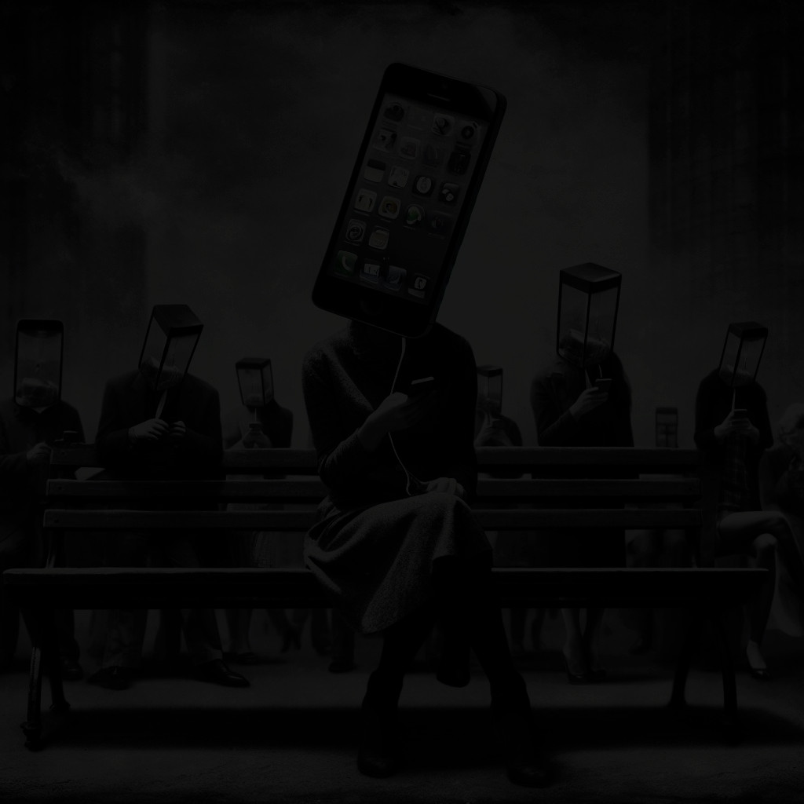
Next steps for me
Revise the SMUFA
Replicate
Intervene based on SMUFA results

Slide 80
Next steps for me
Revise the SMUFA
Replicate
Intervene based on SMUFA results

Slide 81
Next steps for me
Revise the SMUFA
Replicate
Intervene based on SMUFA results

Slide 82
Next steps for you
Use the SMUFA
Replicate
Intervene based on SMUFA results

Slide 83
Next steps for you
Use the SMUFA
Replicate
Intervene based on SMUFA results

Slide 84
Next steps for you
Use the SMUFA
Replicate
Intervene based on SMUFA results

Slide 85
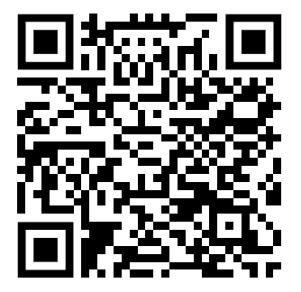
Download the SMUFA here

Slide 86
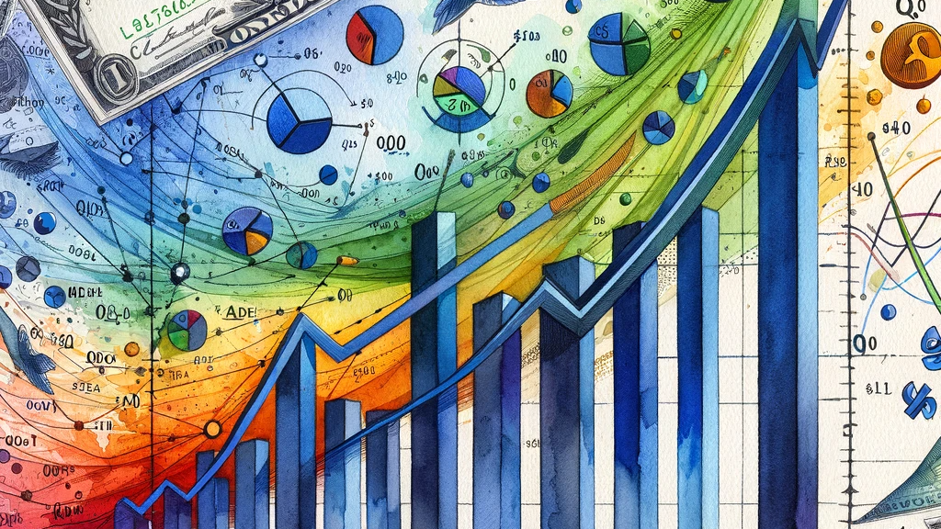
Fifteen Million Merits: A Function-Based Behavioral Economic Demand Assessment of Social Media Use
Notes:
Behavioral economics emphasizes examining the total daily use of reinforcers, such as rewards or incentives, as a key measure of behavior, specifically how this consumption changes based on the cost of these reinforcers. The relationship between cost and consumption, known as the demand curve, helps define the value of these reinforcers. For example, studies have shown that when the cost of necessities like food or water increases, consumption doesn't decrease significantly, showcasing inelastic demand. On the other hand, luxury goods, like vacation travel, have elastic demand, where consumption drops quickly as prices rise. This concept can be extended to understand the demand for drug reinforcers and assess interventions to reduce demand for drugs and other reinforcers.
Total Daily Consumption of Reinforcers: This refers to the total amount of rewards or incentives (reinforcers) that an individual consumes in a day. Behavioral economics suggests that understanding how this consumption changes based on the cost of these reinforcers is crucial for analyzing behavior.
Demand Curve: The demand curve represents the relationship between the cost of a reinforcer and the quantity consumed. As the cost of a commodity (e.g., food, water, or luxury goods) increases, consumption generally decreases, illustrating the demand curve.
Elasticity of Demand: This concept refers to how sensitive consumption is to changes in price.
Inelastic Demand: When the price increases but consumption does not decrease significantly, the demand is termed inelastic. For example, necessities like food and water often show inelastic demand.
Elastic Demand: When consumption decreases sharply with a rise in price, the demand is termed elastic. Luxury goods typically demonstrate elastic demand as consumers can easily forgo or find alternatives when prices rise.
Elasticity as a Continuum: The text suggests that elasticity isn't binary but rather exists on a continuum, with demand for all reinforcers eventually becoming elastic if prices rise sufficiently.
Exponential Model of Demand:
Introduction: Introduced by Hursh and Silberberg (2008), this model aims to quantify and generalize reinforcement relationships, making it applicable to any quantifiable risk or value.
Price and Consumption: In the operant paradigm, price is modeled by fixed-ratio response requirements per reinforcer delivery, while consumption is the total number of reinforcers earned at each price.
Reinforcing Efficacy: The efficacy of a reinforcer is defined by its sensitivity to price changes across a range of prices, rather than consumption at a specific price.
Descriptive Nature of the Model:
The model is descriptive, fitting to measured demand curves to find parameters accounting for variance in the empirical demand curve.
Key Parameters:
Q0: Represents predicted consumption at zero price, isolating the effects of reinforcer magnitude, qualitative differences, and individual physiological differences.
α Parameter: Defines reinforcing efficacy by quantifying sensitivity to price or elasticity of demand across all prices. Larger α values indicate steeper demand curves and less essential value.
Practical Application and Evidence:
Essential Value: The α parameter represents the absolute and theoretically constant reinforcing efficacy of the commodity, termed the "essential value" of the reinforcer.
Comparison of Reinforcer Values:
The Exponential Model allows for a quantitative comparison of reinforcer values independent of intrinsic differences in the physical properties of those reinforcers.

Slide 87
Operant Behavioural Economics
Notes:
Behavioral economics emphasizes examining the total daily use of reinforcers, such as rewards or incentives, as a key measure of behavior, specifically how this consumption changes based on the cost of these reinforcers. The relationship between cost and consumption, known as the demand curve, helps define the value of these reinforcers. For example, studies have shown that when the cost of necessities like food or water increases, consumption doesn't decrease significantly, showcasing inelastic demand. On the other hand, luxury goods, like vacation travel, have elastic demand, where consumption drops quickly as prices rise. This concept can be extended to understand the demand for drug reinforcers and assess interventions to reduce demand for drugs and other reinforcers.
Total Daily Consumption of Reinforcers: This refers to the total amount of rewards or incentives (reinforcers) that an individual consumes in a day. Behavioral economics suggests that understanding how this consumption changes based on the cost of these reinforcers is crucial for analyzing behavior.
Demand Curve: The demand curve represents the relationship between the cost of a reinforcer and the quantity consumed. As the cost of a commodity (e.g., food, water, or luxury goods) increases, consumption generally decreases, illustrating the demand curve.
Elasticity of Demand: This concept refers to how sensitive consumption is to changes in price.
Inelastic Demand: When the price increases but consumption does not decrease significantly, the demand is termed inelastic. For example, necessities like food and water often show inelastic demand.
Elastic Demand: When consumption decreases sharply with a rise in price, the demand is termed elastic. Luxury goods typically demonstrate elastic demand as consumers can easily forgo or find alternatives when prices rise.
Elasticity as a Continuum: The text suggests that elasticity isn't binary but rather exists on a continuum, with demand for all reinforcers eventually becoming elastic if prices rise sufficiently.
Exponential Model of Demand:
Introduction: Introduced by Hursh and Silberberg (2008), this model aims to quantify and generalize reinforcement relationships, making it applicable to any quantifiable risk or value.
Price and Consumption: In the operant paradigm, price is modeled by fixed-ratio response requirements per reinforcer delivery, while consumption is the total number of reinforcers earned at each price.
Reinforcing Efficacy: The efficacy of a reinforcer is defined by its sensitivity to price changes across a range of prices, rather than consumption at a specific price.
Descriptive Nature of the Model:
The model is descriptive, fitting to measured demand curves to find parameters accounting for variance in the empirical demand curve.
Key Parameters:
Q0: Represents predicted consumption at zero price, isolating the effects of reinforcer magnitude, qualitative differences, and individual physiological differences.
α Parameter: Defines reinforcing efficacy by quantifying sensitivity to price or elasticity of demand across all prices. Larger α values indicate steeper demand curves and less essential value.
Practical Application and Evidence:
Essential Value: The α parameter represents the absolute and theoretically constant reinforcing efficacy of the commodity, termed the "essential value" of the reinforcer.
Comparison of Reinforcer Values:
The Exponential Model allows for a quantitative comparison of reinforcer values independent of intrinsic differences in the physical properties of those reinforcers.

Slide 88

Hypothetical Purchase Task (HPT)
Notes:
Introduction to HPTs:
Warren Bickel and Eric Jacobs created a fictitious scenario to study drug demand.
The scenario involves the choice to purchase heroin bags or cigarettes, with controls for drug availability and potential substitutes.
The study found that the consumption pattern from this hypothetical task mirrored actual consumption patterns seen in laboratory studies.
Distinguishing HPTs from Surveys:
Unlike regular surveys, HPTs require respondents to experience all levels of a variable (e.g., various unit prices).
This approach allows researchers to fit a demand model to each respondent's data.
The method reveals how potential policies may affect respondents across various situations.
HPTs offer a comprehensive yet expedient method to study how people value rewards, surpassing traditional stated preference surveys.
Supportive Literature for HPTs:
Literature indicates that HPTs are temporally stable, internally consistent, and have predictive, concurrent, and convergent validity.
HPT results correspond well with actual consumption.
Hypothetical discounting tasks, often used with demand analyses, also show reliability, validity, and correspondence with real outcomes.
The substantial body of literature supports the use of hypothetical self-report methods as accurate reflections of actual behavior, making them suitable for investigation in behavior analysis.

Slide 89
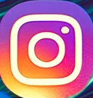
Minutes purchased
Cost
Notes:
So how does a Hypothetical Purchase Task (HPT) work? Imagine you are engaging with Instagram. Here we use Instagram and show it moving along a continuum on the screen. This continuum represents varying 'costs' associated with accessing the app, not in terms of money, but in effort, time, or other personal resources.

Slide 90
Minutes purchased
Cost
Notes:
Visualize yourself at different points along this line, each point reflecting a scenario where the cost to access Instagram increases. At lower costs, your decision to engage with the app might be easy.

Slide 91
Minutes purchased
Cost
Notes:
However, as the cost escalates, think about how your willingness to continue using the app might change. This process reveals how much Instagram's allure holds over you, highlighting its reinforcing value.

Slide 92
Minutes purchased
Cost

Slide 93
Minutes purchased
Cost
Notes:
Our HPT survey was built to quantitatively understand the behavioral economics of social media use. It sheds light on what drives people to continue or reduce their social media usage as the 'price'—the effort, time, or other personal investments—changes.

Slide 94
Minutes purchased
Bx1
Bx2
Cost
Notes:
Notice the non-linear path of the line. It symbolizes that the relationship between the effort you put in and your usage of Instagram isn’t straightforward. It varies based on individual preferences and motivations, such as the need for social connection, information, or an escape from reality.

Slide 95
Hypothetical Purchase Task (HPT) applications
Notes:
Application in Pharmaceuticals and Substance Abuse:
HPTs have been employed to discern dependence levels on substances such as anabolic steroids and prescription drugs. For example, research by Pope et al. (2010) found notable disparities in demand intensity and expenditure between dependent and non-dependent steroid users. Pickover et al. (2016) also observed significant correlations between HPT demand metrics and reported usage of prescription sedatives and stimulants among college students.
Exploring Food Preferences and Addictive Behaviors:
Studies have modified HPTs to evaluate the reinforcing value of different foods among both obese and non-obese adults. Epstein et al. (2010) adapted the cigarette purchase task to assess demand for snacks like potato chips and chocolates, finding consistency with microeconomic principles. Chase et al. (2013) also noted that the demand for chocolate was lower in intensity but higher in elasticity compared to cigarettes among regular smokers.
Examining Services and Addictive Activities:
HPTs have been used to assess the demand for services such as internet access, sex, gambling, and indoor tanning within an addiction framework. For instance, Broadbent & Dakki (2015) found that the demand for internet access on a flight was elastic but greater among problematic users. Studies on gambling and sex also reported varying demand intensities based on preferences and user classifications.
Consumer Goods Beyond Drugs:
HPTs have extended to non-drug commodities, such as motor vehicle fuel, revealing orderly demand curves and metrics. Research by Reed et al. (2014) explored the willingness of participants to drive at different fuel prices, producing predictable demand responses. Further, a study by Roma et al. (2016) systematically assessed demand for a variety of consumer goods and services, yielding prototypical demand curves and excellent model fits.

Slide 96

Study objectives
Via a hypothetical Social Media Purchase Task (SMPT), we aimed to investigate how different functions of use influence value
Notes:
Our research seeks to offer a comprehensive understanding of the factors that drive individuals to engage with social media platforms and the potential reinforcing mechanisms at play.
We sought a comprehensive understanding of the factors that drive individuals to engage with social media platforms and the potential reinforcing mechanisms at play.

Slide 97
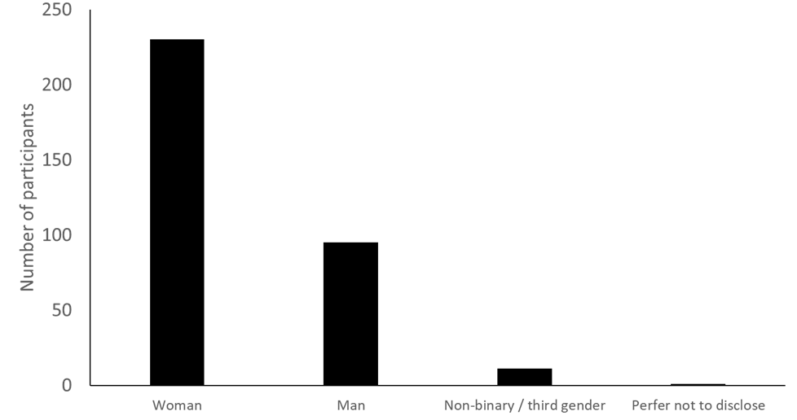
334 participants

Slide 98
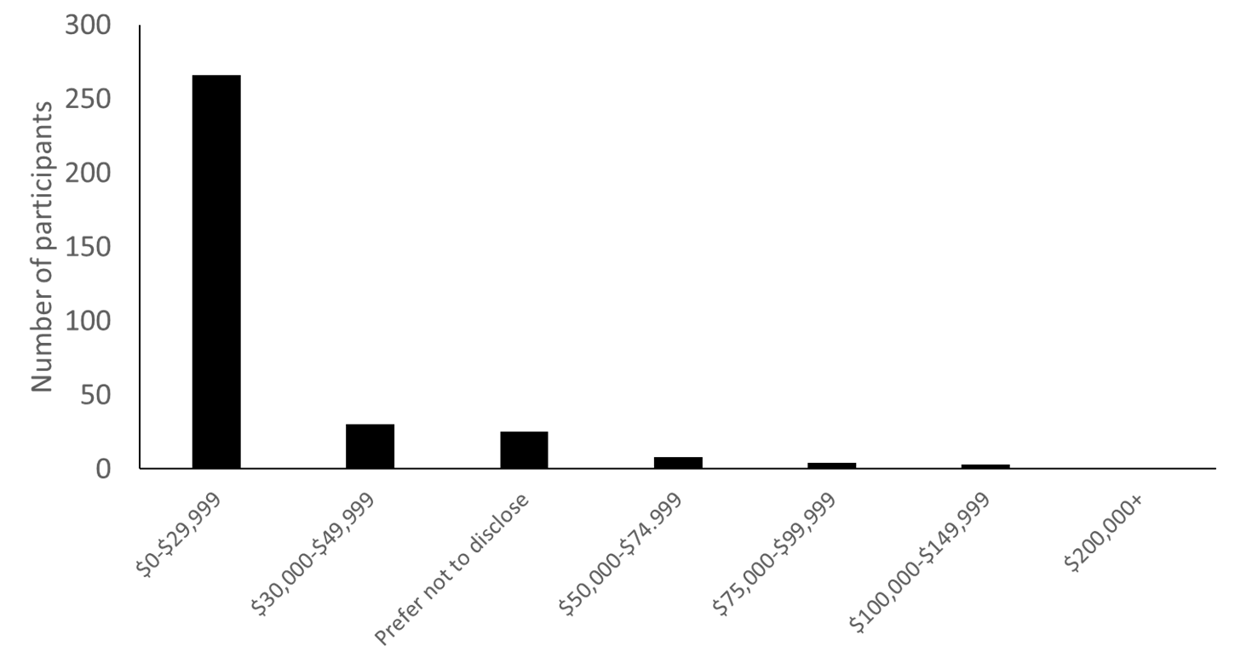

Slide 99
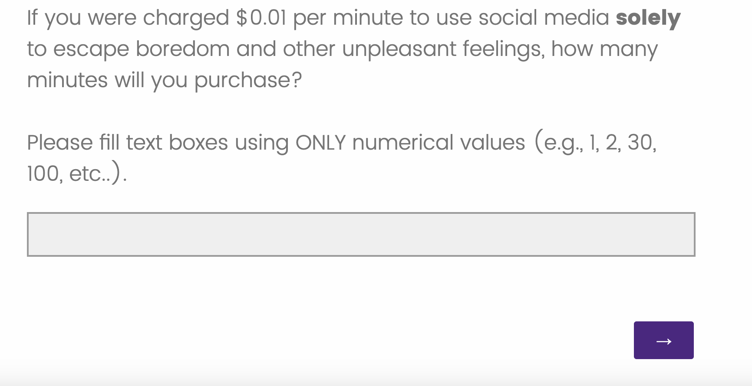

Slide 100
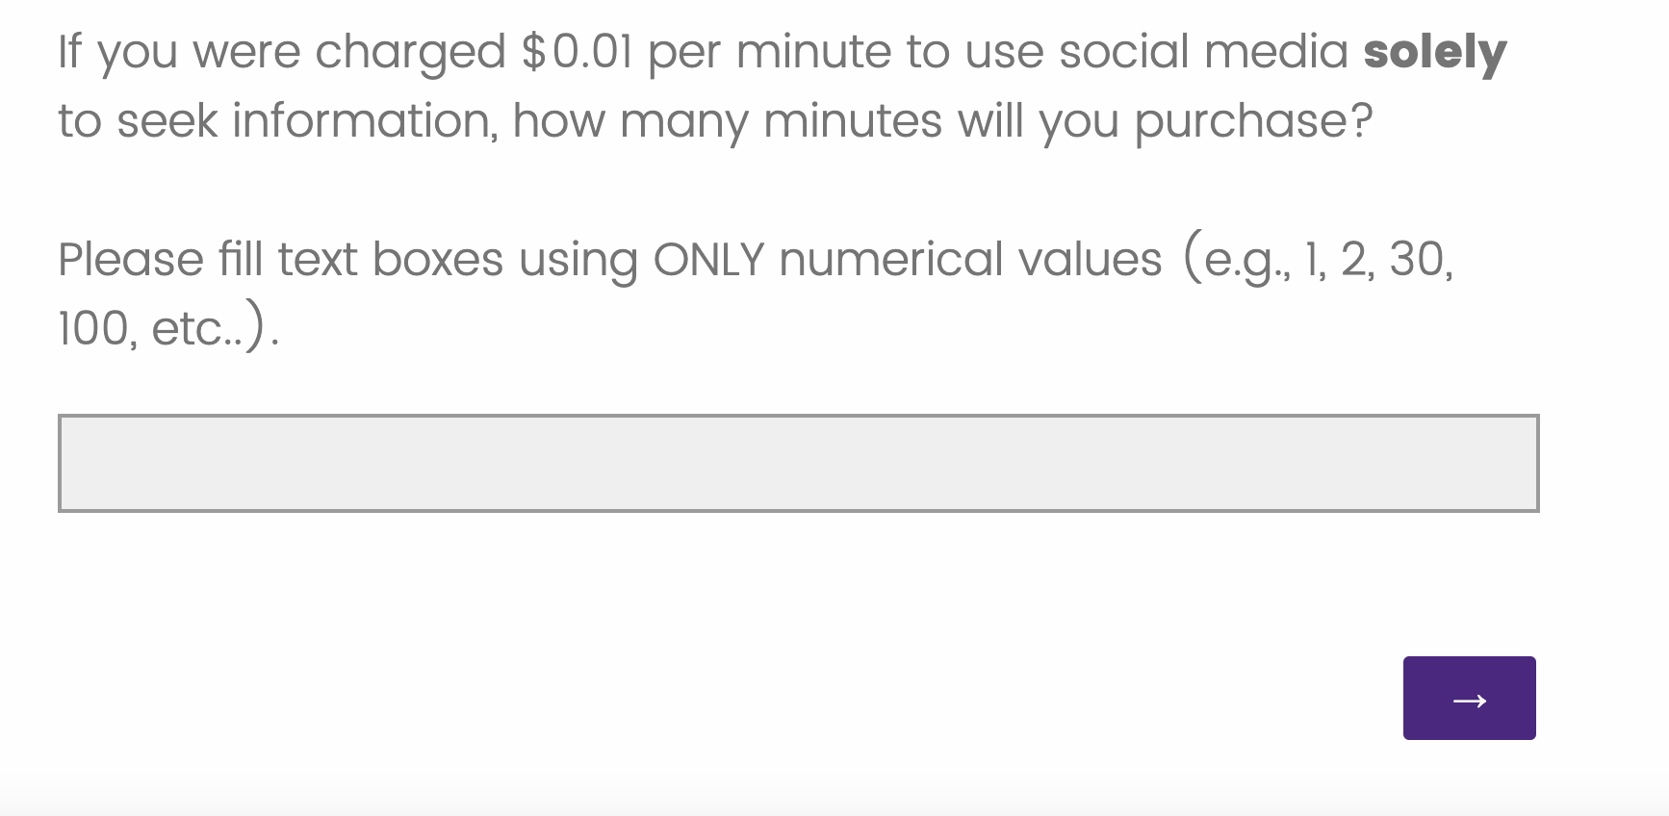

Slide 101
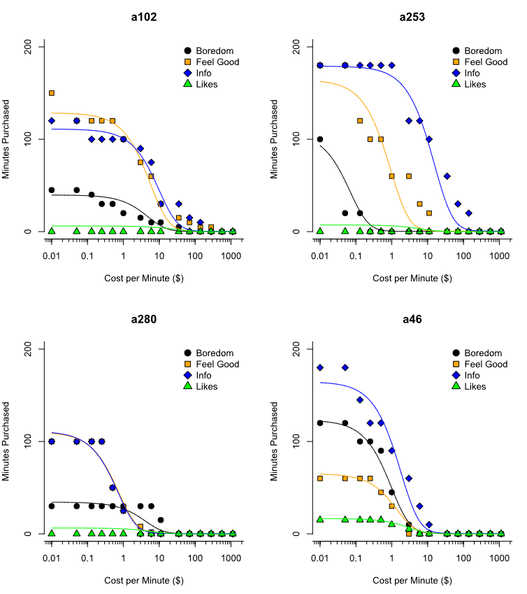
Notes:
Discuss the significance of Q0 and α in the context of different social media functions.
Mention the correlations among individual Q0 and α values across conditions and the lower correlation between intensity and sensitivity.

Slide 102
Notes:
Discuss the significance of Q0 and α in the context of different social media functions.
Mention the correlations among individual Q0 and α values across conditions and the lower correlation between intensity and sensitivity.

Slide 103
Notes:
Discuss the significance of Q0 and α in the context of different social media functions.
Mention the correlations among individual Q0 and α values across conditions and the lower correlation between intensity and sensitivity.

Slide 104
Notes:
Discuss the significance of Q0 and α in the context of different social media functions.
Mention the correlations among individual Q0 and α values across conditions and the lower correlation between intensity and sensitivity.

Slide 105
Notes:
Discuss the significance of Q0 and α in the context of different social media functions.
Mention the correlations among individual Q0 and α values across conditions and the lower correlation between intensity and sensitivity.

Slide 106
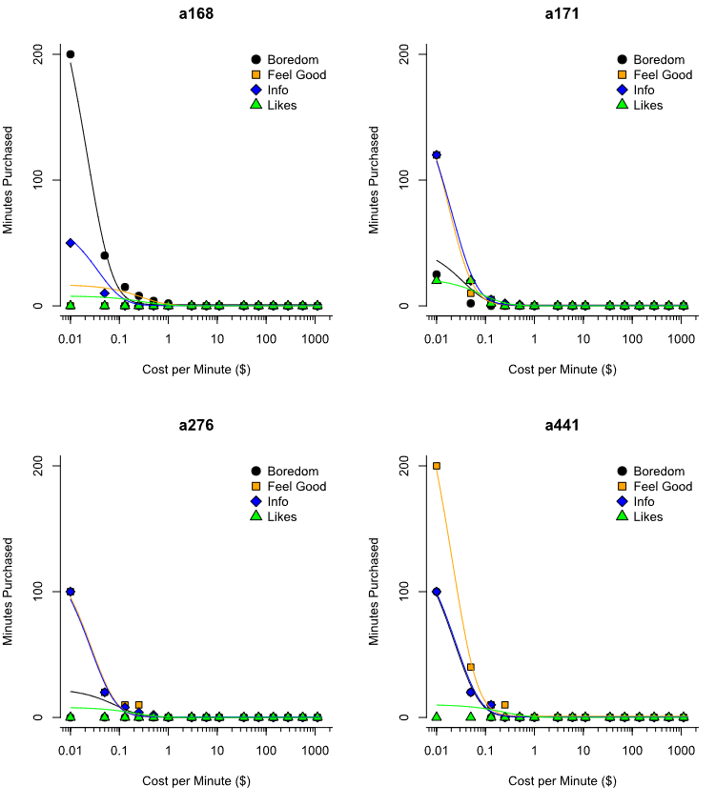
Notes:
Discuss the significance of Q0 and α in the context of different social media functions.
Mention the correlations among individual Q0 and α values across conditions and the lower correlation between intensity and sensitivity.

Slide 107
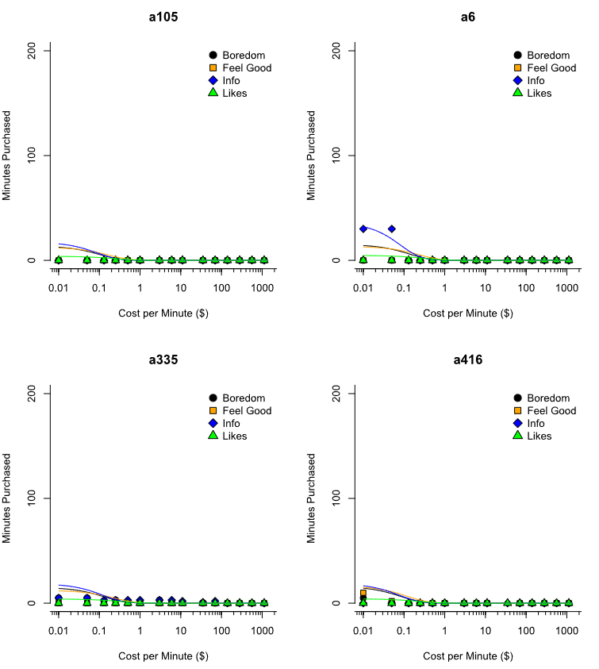
Notes:
Discuss the significance of Q0 and α in the context of different social media functions.
Mention the correlations among individual Q0 and α values across conditions and the lower correlation between intensity and sensitivity.

Slide 108
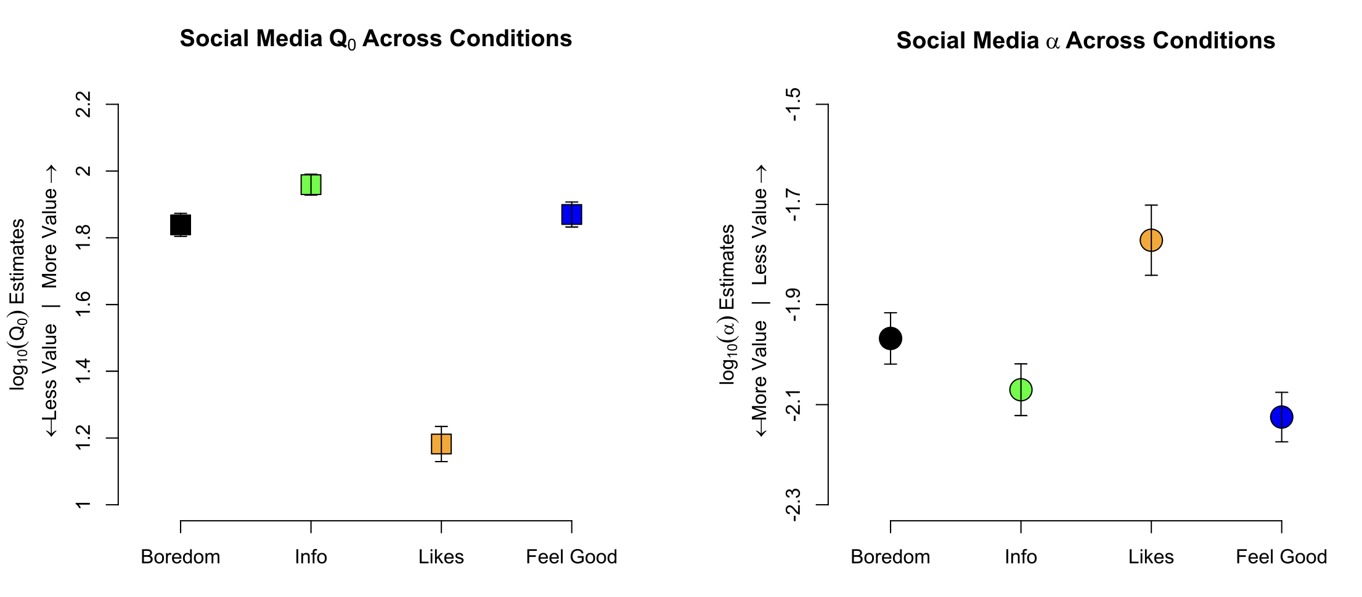
Notes:
Briefly summarize that social media demand varies based on its function and mention the strong fit of the overall model.
Elaborate that participants were more willing to pay for social media for escape, information, and feeling good compared to likes/engagements.

Slide 109
Notes:
Briefly summarize that social media demand varies based on its function and mention the strong fit of the overall model.
Elaborate that participants were more willing to pay for social media for escape, information, and feeling good compared to likes/engagements.

Slide 110

Overall model fit was robust (R²=0.92).
Demand for social media varied based on its function: escape boredom, seek information, positive reinforcement vs. seeking likes/engagements.
Differentiation was consistent across Q₀ (consumption at minimal cost) and α (sensitivity to cost).
No significant difference in willingness to pay for feeling good vs. seeking information, but differences noted in comparison to alleviating boredom.

Slide 111
Overall model fit was robust (R²=0.92).
Demand for social media varied based on its function: escape boredom, seek information, positive reinforcement vs. seeking likes/engagements.
Differentiation was consistent across Q₀ (consumption at minimal cost) and α (sensitivity to cost).
No significant difference in willingness to pay for feeling good vs. seeking information, but differences noted in comparison to alleviating boredom.

Slide 112
Overall model fit was robust (R²=0.92).
Demand for social media varied based on its function: escape boredom, seek information, positive reinforcement vs. seeking likes/engagements.
Differentiation was consistent across Q₀ (consumption at minimal cost) and α (sensitivity to cost).
No significant difference in willingness to pay for feeling good vs. seeking information, but differences noted in comparison to alleviating boredom.

Slide 113
Overall model fit was robust (R²=0.92).
Demand for social media varied based on its function: escape boredom, seek information, positive reinforcement vs. seeking likes/engagements.
Differentiation was consistent across Q₀ (consumption at minimal cost) and α (sensitivity to cost).
No significant difference in willingness to pay for feeling good vs. seeking information, but differences noted in comparison to alleviating boredom.

Slide 114
Limitations
Hypothetical nature of SMPT
Non-clinical participant sample.
Notes:
The validation of Hypothetical Purchase Tasks (HPTs), questionnaires predicting consumer behavior, presents both challenges and opportunities. Ensuring that HPT responses accurately forecast real-world consumption is crucial. While data may show a correlation between HPT demand values and actual consumption, discrepancies can arise from factors such as a varied range of prices and hypothetical bias, where respondents may overestimate real consumption. Nonetheless, advancements in technology and big data management offer promising avenues to validate HPTs. By drawing parallels with social media use research, we can explore how hypothetical interactions on platforms may translate into actual behavior, enhancing our understanding and potentially influencing patterns related to social media use.

Slide 115
Limitations
Hypothetical nature of SMPT
Non-clinical participant sample.
Notes:
The validation of Hypothetical Purchase Tasks (HPTs), questionnaires predicting consumer behavior, presents both challenges and opportunities. Ensuring that HPT responses accurately forecast real-world consumption is crucial. While data may show a correlation between HPT demand values and actual consumption, discrepancies can arise from factors such as a varied range of prices and hypothetical bias, where respondents may overestimate real consumption. Nonetheless, advancements in technology and big data management offer promising avenues to validate HPTs. By drawing parallels with social media use research, we can explore how hypothetical interactions on platforms may translate into actual behavior, enhancing our understanding and potentially influencing patterns related to social media use.

Slide 116
  Study sheds light on behavioral economic underpinnings of social media use.
  Future research: Can this assessment be used as a predictor of social media addiction or even measure changes pre-post treatment?
Notes:
The validation of Hypothetical Purchase Tasks (HPTs), questionnaires predicting consumer behavior, presents both challenges and opportunities. Ensuring that HPT responses accurately forecast real-world consumption is crucial. While data may show a correlation between HPT demand values and actual consumption, discrepancies can arise from factors such as a varied range of prices and hypothetical bias, where respondents may overestimate real consumption. Nonetheless, advancements in technology and big data management offer promising avenues to validate HPTs. By drawing parallels with social media use research, we can explore how hypothetical interactions on platforms may translate into actual behavior, enhancing our understanding and potentially influencing patterns related to social media use.

Slide 117
  Study sheds light on behavioral economic underpinnings of social media use.
  Future research: Can this assessment be used as a predictor of social media addiction or even measure changes pre-post treatment?
Notes:
The validation of Hypothetical Purchase Tasks (HPTs), questionnaires predicting consumer behavior, presents both challenges and opportunities. Ensuring that HPT responses accurately forecast real-world consumption is crucial. While data may show a correlation between HPT demand values and actual consumption, discrepancies can arise from factors such as a varied range of prices and hypothetical bias, where respondents may overestimate real consumption. Nonetheless, advancements in technology and big data management offer promising avenues to validate HPTs. By drawing parallels with social media use research, we can explore how hypothetical interactions on platforms may translate into actual behavior, enhancing our understanding and potentially influencing patterns related to social media use.

Slide 118
amalkin5@uwo.ca

