Slide 1
Presentation and Public Speaking Skills: A Panel
Dr. Albert Malkin (Assistant Professor, Faculty of Education)
Andrew Graham (Communications and Community Engagement Officer)
Jenny Kassen (PhD Candidate, Sessional Instructor, Faculty of Education)
Hosted by the Research Office at the Faculty of Education

Slide 2
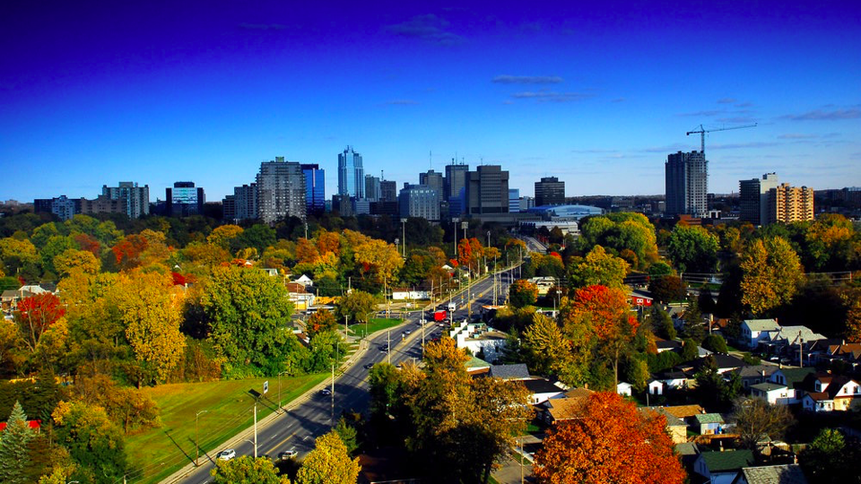

Slide 3
Agenda
How do you prep for speaking during public speaking events?
How do you engage your audiences during public speaking presentation events? Tips and tricks of talking or what you include in your slides or poster.
What are the key differences between well-structured slides/posters and slides/posters that need improvement?
What is some advice to keep in mind when you are answering questions?
How do you disseminate your research to media, including social media?
What are some tips and tricks to remember when public speaking and presenting virtually (on Zoom)?

Slide 4
How do you prep for speaking during public speaking events?

Slide 5
How do you engage your audiences during public speaking presentation events? Tips and tricks of talking or what you include in your slides or poster.

Slide 6
What are the key differences between well-structured slides/posters and slides/posters that need improvement?

Slide 7
My Approach to Public Speaking Sample Slides
Albert Malkin, PhD, BCBA-D
Faculty of Education

Slide 9
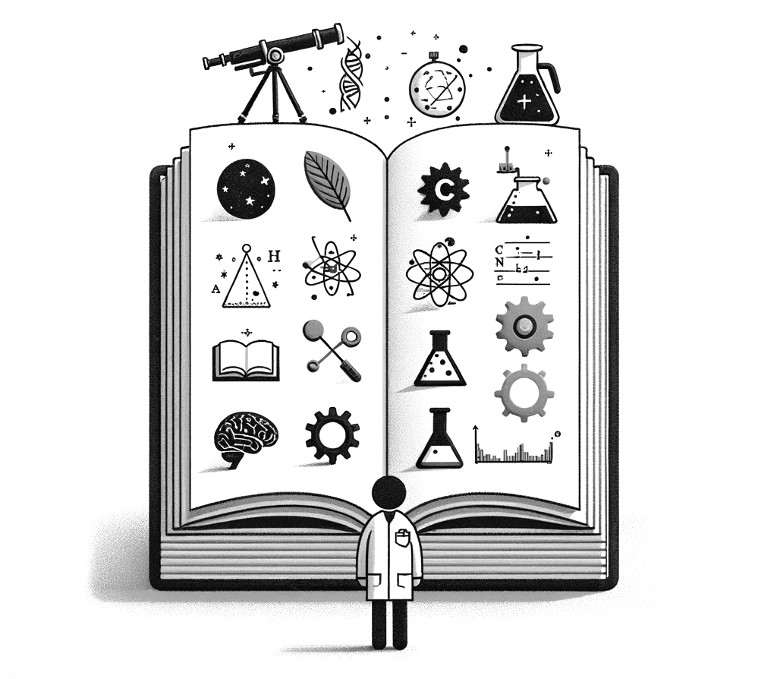
Notes:
No matter what field you’re in. Science is a natural story.
So I try to tell a compelling story.

Slide 10
Story telling
Narrative Structure: Like a story, scientific inquiry often follows a narrative structure. There's an introduction (background or literature review), a buildup (hypothesis and experimentation), a climax (discovery or results), and a conclusion (analysis and interpretation). This structure helps in making scientific findings more comprehensible and engaging.
Character Development: In science, the "characters" can be the scientists, the phenomena under study, or even the experiments themselves. Their development, much like characters in a story, is crucial for understanding the narrative of the scientific process.
Conflict and Resolution: Just as stories often revolve around a central conflict and its resolution, scientific research frequently involves identifying a problem or question and seeking a resolution or answer through research and experimentation.
Themes and Morals: Stories often have underlying themes or morals, and so does scientific research. These can include ethical considerations, the impact of science on society, or the pursuit of knowledge.
Evolution Over Time: Just as stories can evolve with new interpretations or sequels, scientific understanding also evolves over time with new research, discoveries, and technological advancements.

Slide 11
Story telling
Narrative Structure: Like a story, scientific inquiry often follows a narrative structure. There's an introduction (background or literature review), a buildup (hypothesis and experimentation), a climax (discovery or results), and a conclusion (analysis and interpretation). This structure helps in making scientific findings more comprehensible and engaging.
Character Development: In science, the "characters" can be the scientists, the phenomena under study, or even the experiments themselves. Their development, much like characters in a story, is crucial for understanding the narrative of the scientific process.
Conflict and Resolution: Just as stories often revolve around a central conflict and its resolution, scientific research frequently involves identifying a problem or question and seeking a resolution or answer through research and experimentation.
Themes and Morals: Stories often have underlying themes or morals, and so does scientific research. These can include ethical considerations, the impact of science on society, or the pursuit of knowledge.
Evolution Over Time: Just as stories can evolve with new interpretations or sequels, scientific understanding also evolves over time with new research, discoveries, and technological advancements.

Slide 12
Story telling
Narrative Structure: Like a story, scientific inquiry often follows a narrative structure. There's an introduction (background or literature review), a buildup (hypothesis and experimentation), a climax (discovery or results), and a conclusion (analysis and interpretation). This structure helps in making scientific findings more comprehensible and engaging.
Character Development: In science, the "characters" can be the scientists, the phenomena under study, or even the experiments themselves. Their development, much like characters in a story, is crucial for understanding the narrative of the scientific process.
Conflict and Resolution: Just as stories often revolve around a central conflict and its resolution, scientific research frequently involves identifying a problem or question and seeking a resolution or answer through research and experimentation.
Themes and Morals: Stories often have underlying themes or morals, and so does scientific research. These can include ethical considerations, the impact of science on society, or the pursuit of knowledge.
Evolution Over Time: Just as stories can evolve with new interpretations or sequels, scientific understanding also evolves over time with new research, discoveries, and technological advancements.

Slide 13
Story telling
Narrative Structure: Like a story, scientific inquiry often follows a narrative structure. There's an introduction (background or literature review), a buildup (hypothesis and experimentation), a climax (discovery or results), and a conclusion (analysis and interpretation). This structure helps in making scientific findings more comprehensible and engaging.
Character Development: In science, the "characters" can be the scientists, the phenomena under study, or even the experiments themselves. Their development, much like characters in a story, is crucial for understanding the narrative of the scientific process.
Conflict and Resolution: Just as stories often revolve around a central conflict and its resolution, scientific research frequently involves identifying a problem or question and seeking a resolution or answer through research and experimentation.
Themes and Morals: Stories often have underlying themes or morals, and so does scientific research. These can include ethical considerations, the impact of science on society, or the pursuit of knowledge.
Evolution Over Time: Just as stories can evolve with new interpretations or sequels, scientific understanding also evolves over time with new research, discoveries, and technological advancements.

Slide 14
Narrative Structure
Introduction (background or literature review)
A buildup (hypothesis and experimentation)
Climax (discovery or results)
Conclusion (analysis and interpretation)
Notes:
Talk about black v. white background

Slide 15
Narrative Structure
Introduction (background or literature review)
A buildup (hypothesis and experimentation)
Climax (discovery or results)
Conclusion (analysis and interpretation)
Notes:
Talk about black v. white background

Slide 16
Narrative Structure
Introduction (background or literature review)
A buildup (hypothesis and experimentation)
Climax (discovery or results)
Conclusion (analysis and interpretation)

Slide 17
Narrative Structure
Introduction (background or literature review)
A buildup (hypothesis and experimentation)
Climax (discovery or results)
Conclusion (analysis and interpretation)

Slide 18
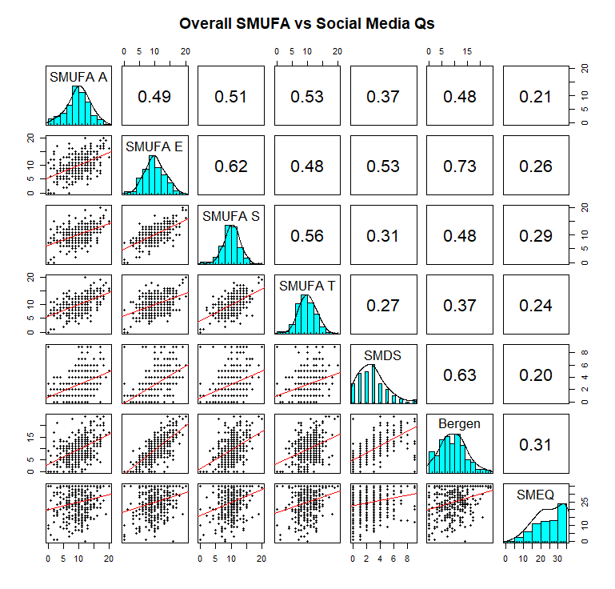
Notes:
The SMUFA escape subscore was most strongly related to the BSMS and SMDS, whereas the SMEQ (past week use) had the weakest relationship to SMUFA scores as well as the BSMS and SMDS. Overall SMUFA scores also were most related to the BSMS.

Slide 19
Notes:
The SMUFA escape subscore was most strongly related to the BSMS and SMDS (both ask about the past year use)
whereas the SMEQ (past week use) had the weakest relationship to SMUFA
scores as well as the BSMS and SMDS. Overall SMUFA scores also were most related to the BSMS.

Slide 20
Notes:
The SMUFA escape subscore was most strongly related to the BSMS and SMDS (both ask about the past year use)
whereas the SMEQ (past week use) had the weakest relationship to SMUFA
scores as well as the BSMS and SMDS. Overall SMUFA scores also were most related to the BSMS.

Slide 21
Notes:
The SMUFA escape subscore was most strongly related to the BSMS and SMDS (both ask about the past year use)
whereas the SMEQ (past week use) had the weakest relationship to SMUFA
scores as well as the BSMS and SMDS. Overall SMUFA scores also were most related to the BSMS.

Slide 22
Notes:
The SMUFA escape subscore was most strongly related to the BSMS and SMDS (both ask about the past year use)
whereas the SMEQ (past week use) had the weakest relationship to SMUFA
scores as well as the BSMS and SMDS. Overall SMUFA scores also were most related to the BSMS.

Slide 23
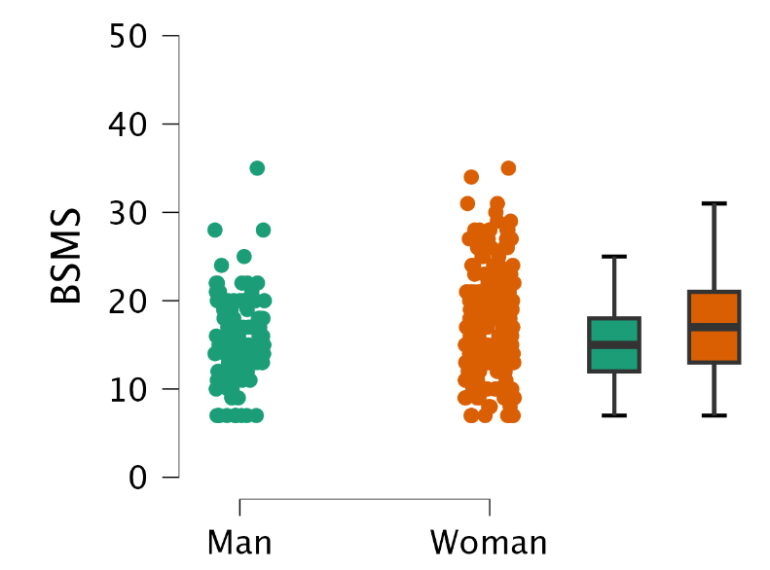

Slide 27
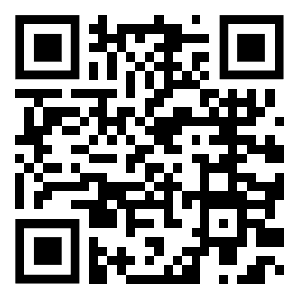

Slide 28
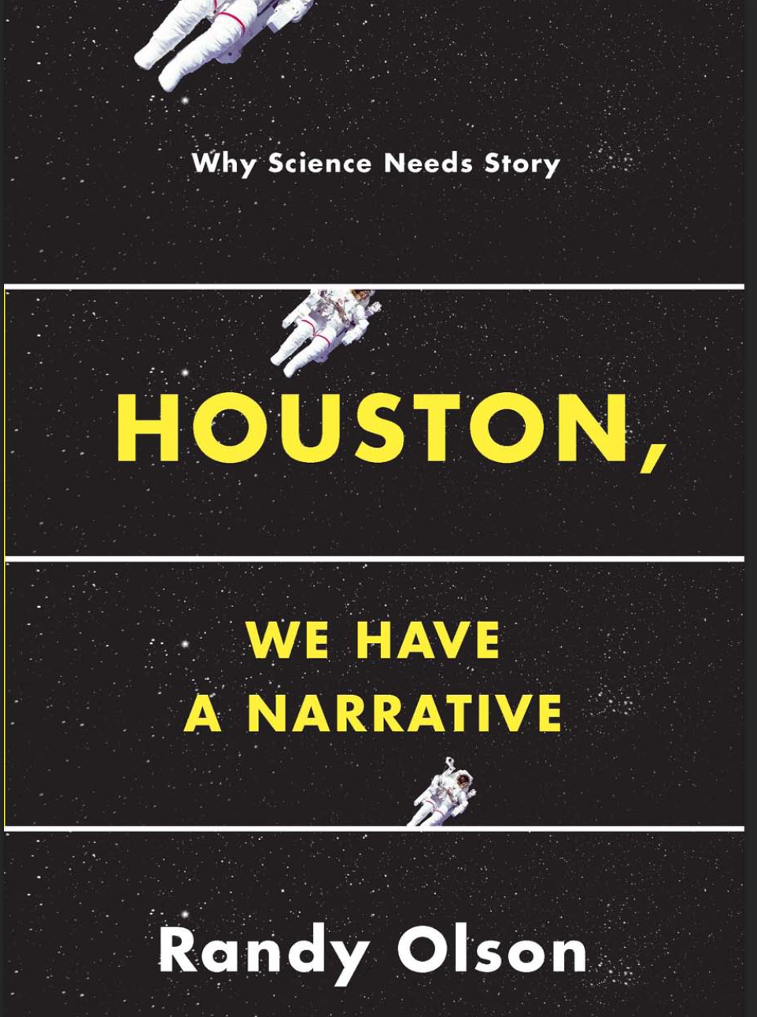
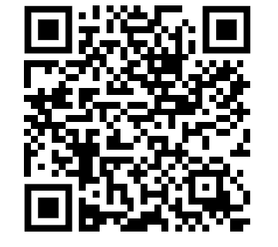

Slide 29
What is some advice to keep in mind when you are answering questions?

Slide 30
How do you disseminate your research to media, including social media?

Slide 31
What are some tips and tricks to remember when public speaking and presenting virtually (on Zoom)?

Slide 32
What do you wish you would’ve known when you first began public speaking and presenting?

Slide 33
If there is a strict limit, what should you focus on during a timed research presentation?

Slide 34
Thank you for coming!

