Slide 2
Conference Information – Part 2
Mali M. Allaf, Ph.D.
Research Officer
January 25th, 2023

Slide 3
Academic conference
An academic conference is an event where researchers present their work and findings in a particular field to their peers.
To allow professionals to connect
Discuss issues
Share information
Improve presentation skills

Slide 4
Hooray, we are going to a conference

Slide 5
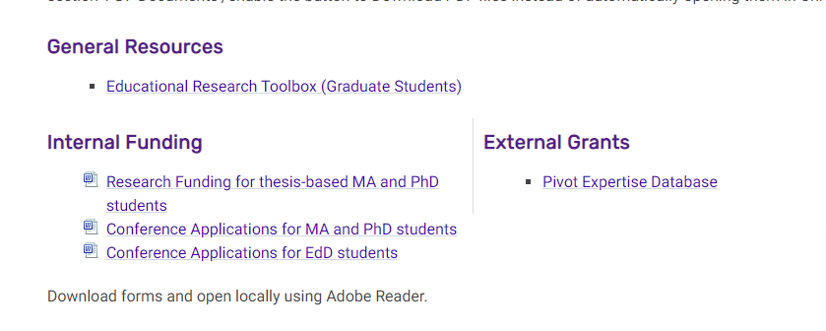
Conference fundings
Supervisor’s Grants
Research Office

Slide 6
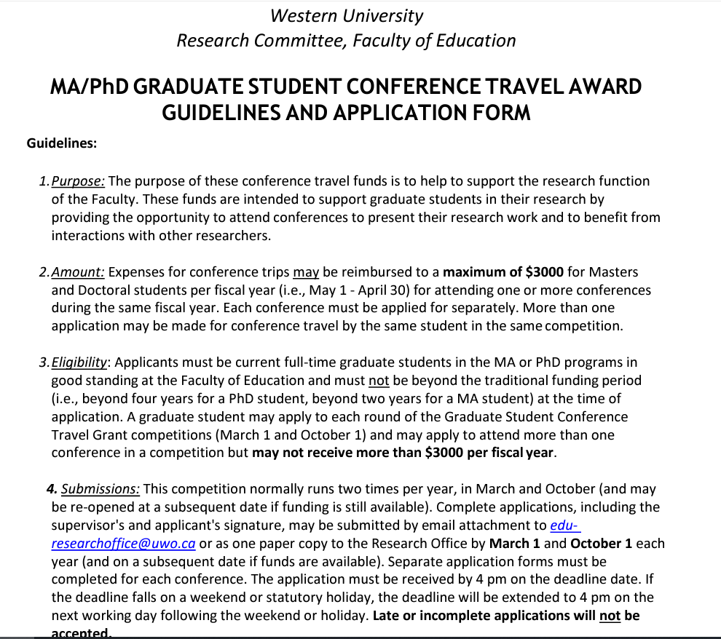
https://www.edu.uwo.ca/research/research-office/docs/MA-PhD_ConferenceApplicationForm-Spring2023.pdf

Slide 7
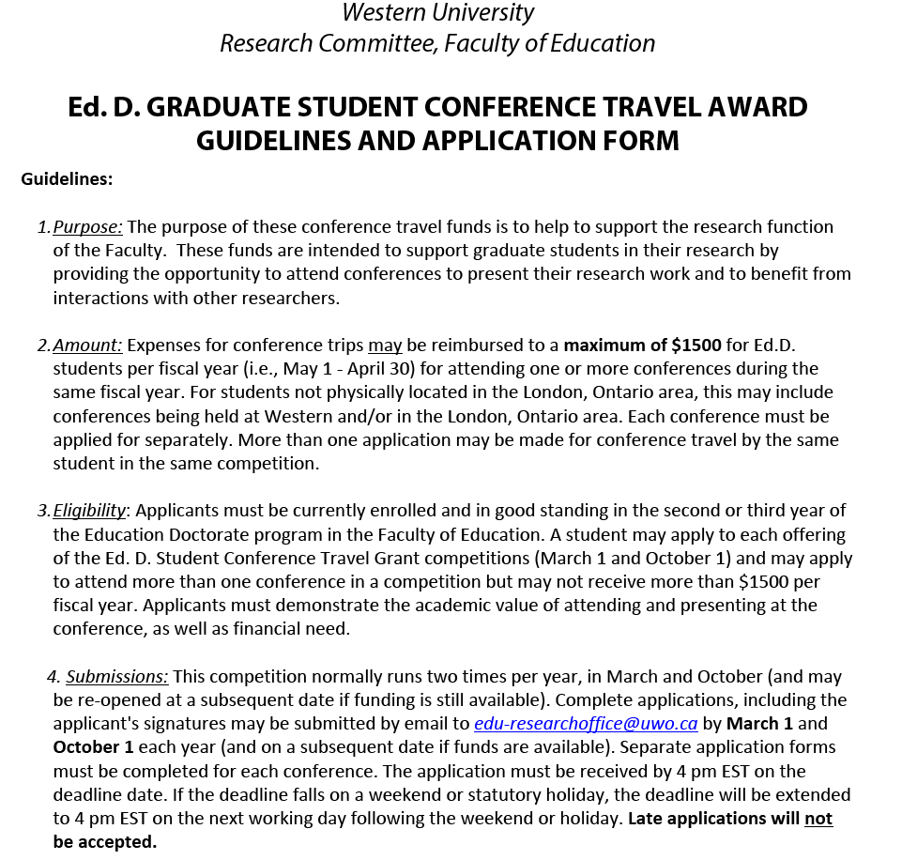
https://www.edu.uwo.ca/research/documents/EdD_Conference_Travel-ApplicationForm-Spring2022.pdf

Slide 8
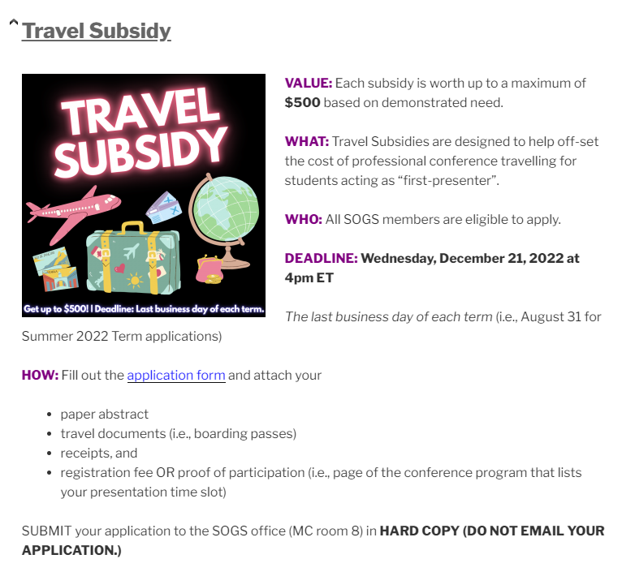
http://sogs.ca/subsidies/

Slide 9
https://www.psac610.ca/

Slide 10
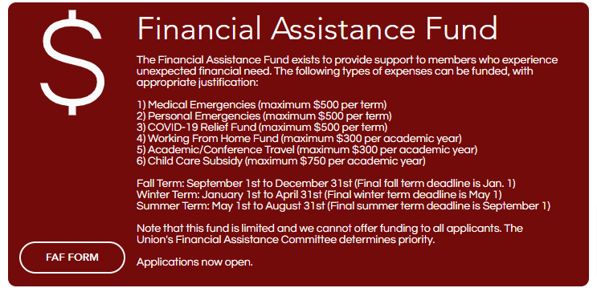
https://www.psac610.ca/teaching-assistant-benefits

Slide 11
Some conferences have Travel Awards Competition.

Slide 12
http://sogs.ca/academic-joint-fund/

Slide 13
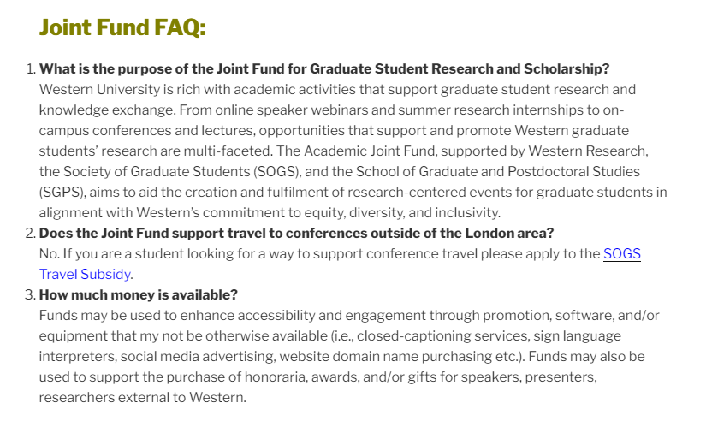
http://sogs.ca/academic-joint-fund/

Slide 14
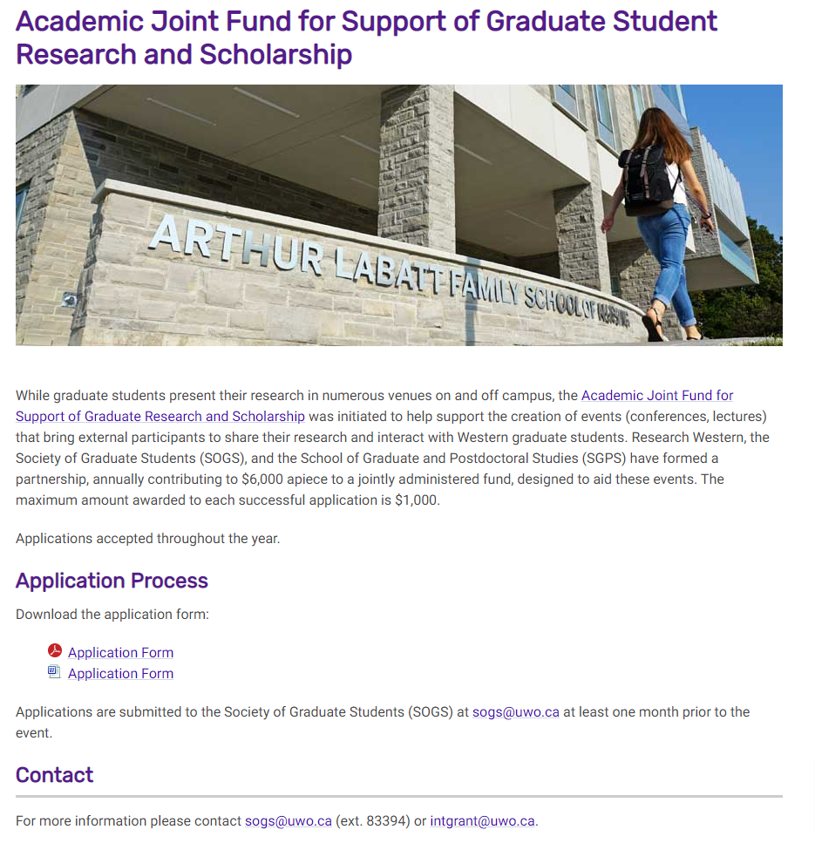
https://uwo.ca/research/funding/internal/joint_fund_for_graduate_research.html

Slide 15
How to Survive a Conference
Prepare your presentation or poster
Practice
Check the agenda
Look at the range of papers
Search speakers
Select the right sessions and workshops
Be confident
Ask questions and be engaged
Take notes

Slide 16
Networking
Remember to network
Plan whom you want to network with
Arrange to talk to key people ahead of the conference (recommended)
Practise your elevator pitch
Follow up on any connections

Slide 17
Networking tips
Do your homework on your potential network
Design your schedule with networking in mind
Prepare some conversation starters
Refine your personal elevator pitch
Plan your exit strategy
Network on the conference app
Bring business cards (but don’t rely on them)
Keep a business card bank (and cash it in later)
Keep networking after the conference ends

Slide 18
LinkedIn Workshop- February 9: 12-1 pm
Getting ‘LinkedIn’ – Utilizing Social Media as Part of Your Career Action Plan
Did you know that approximately 90% of companies use LinkedIn for recruiting and more than 75% of recruiters regularly use LinkedIn?
LinkedIn is a powerful job search tool if used correctly.
Learn how to set up and optimize your profile and best utilize LinkedIn so that you can build your brand, be aware of the opportunity around you, and become known to others in your area or field of interest.
Attend this session to explore the various ways by which you can utilize LinkedIn as a valuable asset in your job search.
When: February 9 from 12-1 p.m.
Presenter: Craig Ingram, Manager, Career Education, Western University
To pre-register and access the Zoom link please contact Education Research Office:
edu-researchoffice@uwo.ca

