Slide 1
Curating Your Online Publication Profile with ORCID
October 18, 2022
Notes:
Check with Arielle about poll questions

Slide 2
Land Acknowledgement
Notes:
Ask Mali to do it

Slide 3
The team
Emily Carlisle-Johnston
Noah Churchill-Baird
Kristin Hoffmann
Alanna Marson
Arielle VanderSchans
Courtney Waugh
rsclib@uwo.ca
Notes:
Add Qualtrics link to chat with survey

Slide 4
ORCID iD
Yellow orchid branch with water drops, CC-BY Marco Verch
Notes:
Not talking about orchid the flower, talking about open researcher contributor and ID

Slide 5
What is an online publication profile?
Benefits of ORCID iDs
Steps to set up your ORCID iD
Question & Answer period
Notes:
Launch poll – What is your familiarity with ORCID iDs? (continuum from full profile to never heard of it).
Arielle will need to set up poll

Slide 6
Online Publication Profiles
A way to curate a record of research, or collation, of your research outputs and other scholarly achievements.
Some provide a persistent digital identifier that distinguishes you from every other researcher.
Notes:
Talking about ORCID, Google, SCOPUS/Web of Science

Slide 7
ORCID vs. Other Profiles
Scopus Author ID & Researcher ID: automatically assigned to you once your publication is indexed in Scopus or Web of Science.
Google Scholar: captures papers indexed in Google; can be manually updated
Notes:
Talking about ORCID, Google, SCOPUS/Web of Science
These are ones you intentionally create vs. ones that just exist. Scopus and Web of Science don’t automatically integrate
Main thing we want you to know about ORCID is it integrates with other systems; video will talk about it

Slide 8
Notes:
Main thing we want you to take away is it integrates with other systems

Slide 9
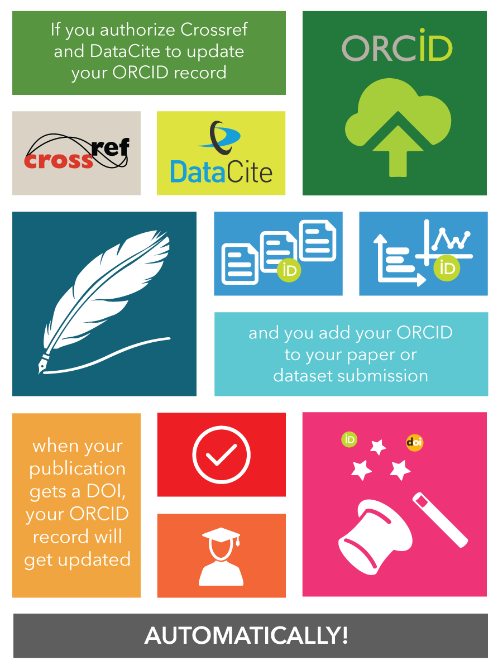
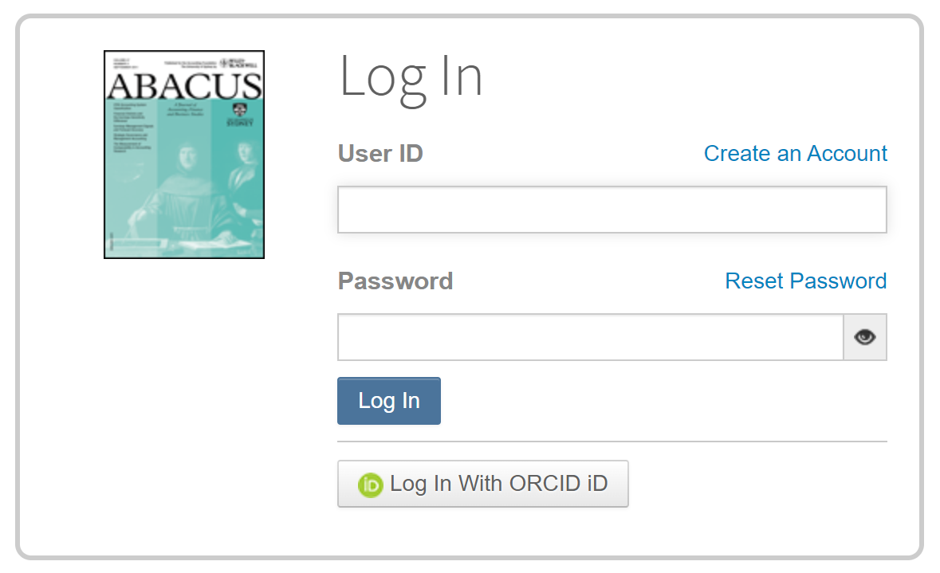
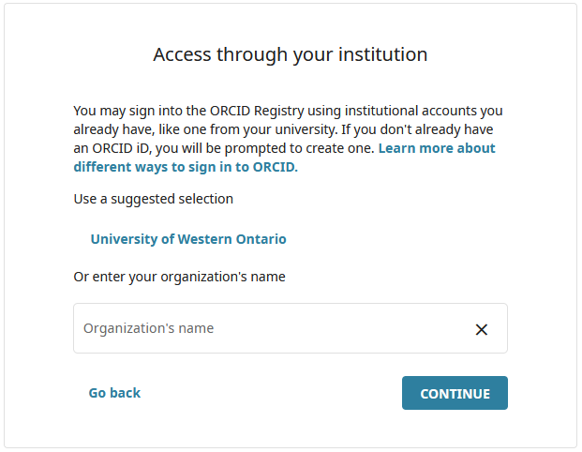
Automatic Updates
Single Sign-In
Notes:
Title Page

Slide 10
https://orcid.org
Sign in / Register
30 seconds to create your ORCID iD
Use your uwo.ca email as your Primary email
Notes:
Aligns with handout that has registration – share handout in chat during session

Slide 11
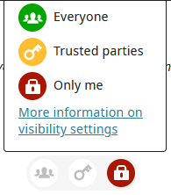
Add to your profile
Names (Also known as)
Country
Websites
Other email addresses
Choose your visibility settings:
Notes:
Add basic biographical information
Don’t spend more than 2 minutes on this part, but definitely add other names (also known as) because this will help with “search & link” features.
With every piece of information you add to your ORCID profile, you can choose the visibility settings you want: Everyone, Trusted parties, or Only me

Slide 12
Add to your profile
Employment
Education and qualifications
Invited positions and distinctions
Membership and service
Funding (can search & link)
Notes:
Most of these you’ll enter manually, which can get tedious – it’s like putting stuff into the CCV.
Funding – can use “search & link” which connects to Dimensions Wizard
Includes dozens of Canadian funding agencies including SSHRC, and many cancer and health-related funding agencies, and many from other countries. May not find so many that are relevant to you because it’s taking off in many areas like cancer and health
Or enter funding manually.
Suggest not spending much time on this part today, but make a note to come back to it.

Slide 13
Add to your profile
Works (i.e., publications)
Adding Works to your ORCID profile can be time-consuming and tedious, but it is IMPORTANT.
Notes:
This is what takes the most time. This is where you are most likely to run in to questions and challenges, so you can try to work on some today and ask us later, or follow-up with us after the session.

Slide 14
Notes:
Title Page

Slide 15
Adding Works
Use Search & Link wizards:
Scopus
The Lens
Crossref Metadata Search
If not found there, then use BibTeX import or Add manually.
Notes:
As you saw in the video, adding alternate names can be helpful for the Search & Link wizards.
Suggested order:
Scopus – easiest to use, good metadata
The Lens – there are a few steps involved, including creating an account with The Lens, but it’s pretty comprehensive and can find more in social sciences & humanities than Scopus (suggest doing a screenshare during session. See notes in PDF about how to do this). Lens.org
Crossref Metadata Search – anything with a DOI should be found here. I find the search sometimes times out…
BibTeX – there are more steps to follow to get your publication information into BibTeX format
This is what you have to do if you want to import from Google Scholar (which doesn’t usually have complete metadata so we encourage Scopus or The Lens first)
Could also be helpful if you have a list of your publications in a reference manager such as Zotero
Add manually – as a last resort, if you can’t find your work anywhere else. Less ‘trusted’ but it’s better to have your works there than not at all.

Slide 16
Demo of The Lens
Notes:
Ask Mali to do it

Slide 17
Trusted Individuals
= other ORCID iD holders to whom you have granted permissions to edit your ORCID record.
Account settings > Trusted individuals
Search for their name
Notes:
If you want to be a Trusted Individual for someone else, they have to add you.
If you want someone to help you, you have to add them. DO NOT SHARE LOGIN DETAILS.
Example: grad research assistant working for a prof

Slide 18
It may take some time
If you published under several names or name variations
If your publications aren’t indexed in Scopus or easily findable in The Lens
If your publications don’t have DOIs
If you publish mostly not in journal articles, or in other languages
Notes:
Only have to do the work once to get profile up to date and then don’t have to really think about it again (if a journal isn’t integrated with ORCID)

Slide 19
Questions?
Notes:
Open it up for questions; offer to help people 1:1 in breakout rooms if they want to try something themselves or if the question needs screensharing.

Slide 20
For further help
Emily Carlisle-Johnston
Noah Churchill-Baird
Kristin Hoffmann
Alanna Marson
Arielle VanderSchans
Courtney Waugh
rsclib@uwo.ca
Notes:
Add Qualtrics link to chat with survey

Slide 21
Notes:
Main Page

