Slide 2
OGS, Tri-Council, Grant Writing: How to put together a superior funding request
Nicole Neil
Associate Professor
Associate Dean (Research)
Coordinator, MPEd in the field of Applied Behaviour Analysis
November, 2022

Slide 3
Initial suggestions for writing your application

Slide 4
Answer all questions asked in the application
Organize peer review for your application
Read others’ grants.
Essential: At the beginning of your funding application, even if it is not requested of you, concisely say:
WHAT
State what you are planning on doing
HOW
Say how it will be done (e.g. I will do x, y, z projects)
EFFECT
State
the specific contributions of your research
the important effects of your research
Notes:
Following these basic suggestions should give you a major advantage, simply because few applicants do all three:

Slide 5
Specific suggestions for success

Slide 6
Opening section/lines of the application This can serve to set the tone and engender an enthusiastic response to your work. Be confident, not boastful as you write. Concrete evidence or examples Whenever you can explain your qualifications and what you describe. Write a concrete, realizable plan Convince the reviewers that you are a good bet to get the research done

Slide 7
Respond to each and every one of the evaluation criteria outlined in the application materials provided by the funding body. Separate heading for every question and sub-question you are asked to respond to in your first draft. Respond to each and every question. Afterward, you can remove or incorporate your headings. Write to your intended audience. Remember that not all reviewers will be experts in your field. Some might be from a different discipline altogether (depending upon the funding opportunity), or in some cases, reviewers might not even be academics.

Slide 8
Methods Remember that it is your methodology against which your application will be judged. Reviewers must like your CV and the project but then it is usually the description of the method that will see you funded or not. Be sure that your methods description is absolutely clear. Insufficient detail / hard to follow = not successful. So… describe everything and be explicit – don’t assume that your reviewer will make understand or make any links you leave implied.

Slide 9
Again… how to begin any grant*
On the first page:
WHAT
State generally what you are planning on doing
HOW
Say how it will be done (e.g. we will do projects x, y, z)
EFFECT
State explicitly what will be the
specific contributions and
the important effects of your research
This should take three or four sentences. Then go on to answer the grant’s questions. You must make your reviewer care right from the outset. *not possible for OGS when you have only one page – in that case, just follow the application instructions

Slide 10
Additional application tips

Slide 11
Your grant must be understandable
even to those who know nothing about your work
Explain all terms and avoid jargon when possible
used terms must have meanings agreed upon by all in any field that might review your application
Make your writing clear, interesting,
at the level of, say, a Harpers or Economist article (not excessively academic)
Leave white space and put lists on separate lines when possible
Imagine that your grant will be read along with 5 others on a commuter flight at 11 pm
I like to imagine a clever nonacademic in my head when writing a grant. You are writing to her/him

Slide 12
Templates

Slide 13
Templates for how to structure your proposal
After giving three lines for an overview, use Heather Brown’s Templates available on the Graduate Student Research Blog
http://westerngradresearch.files.wordpress.com/2013/10/brown-how-to-structure-an-ogs-or-sshrc-proposal.pdf
This is older but it provides clear information and good templates to follow for Masters and Ph.D. applications

Slide 14
OGS applications

Slide 15
December 7, 2022 – Western’s online 2023-2024 OGS/QEII-GSST application opens.
February 1, 2023 – Final submission deadline. Application closes at 4:00 p.m. (EST).
May 1, 2023 – Announcement of 2023-2024 OGS/QEII-GSST results.
$15,000 for one year (three consecutive terms)
Merit based. This will be a pared-down version of your thesis, giving outcomes and your contributions to the field.
Information at:
https://grad.uwo.ca/finances/external_funding/ogs.html
http://grad.uwo.ca/doc/financial_support/scholarships/OGS_application_handbook_2022-2023.pdf
https://osap.gov.on.ca/OSAPPortal/en/A-ZListofAid/PRDR019245.html

Slide 16
CGS-M and CGS-D SSHRC, CIHR and NSERC

Slide 17
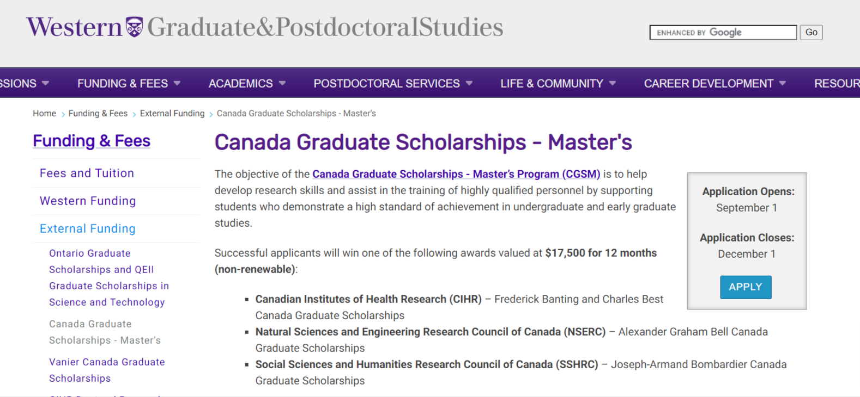
https://grad.uwo.ca/finances/external_funding/cgsm.html

Slide 18
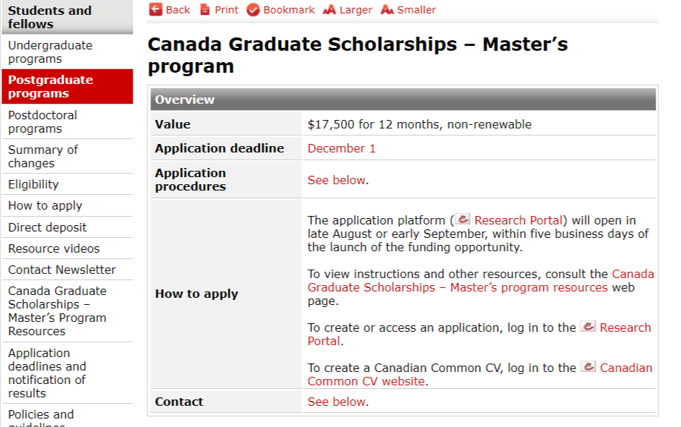
https://www.nserc-crsng.gc.ca/Students-Etudiants/PG-CS/CGSM-BESCM_eng.asp#Deadlines

Slide 19
Eligibility – CGS-M
Be a Canadian citizen, a permanent resident of Canada or a Protected Person under subsection 95(2) of the Immigration and Refugee Protection Act (Canada) as of the application deadline date
Be enrolled in, have applied for or will apply for full-time admission to an eligible graduate program at the master’s or doctoral level at a Canadian institution with a CGS M allocation
Have completed, as of December 31 of the year of application either between 0 and 12 months of full-time studies (or full-time equivalent) in the program for which you are requesting funding
Not have held or be currently holding a CGS M scholarship from CIHR, NSERC or SSHRC
Have achieved a first-class average, as determined by the host institution, in each of the last two completed years of study (full-time equivalent)
Submit a maximum of one scholarship (master’s or doctoral) or fellowship application per academic year to either CIHR, NSERC or SSHRC
https://www.nserc-crsng.gc.ca/Students-Etudiants/PG-CS/CGSM-BESCM_eng.asp#Deadlines

Slide 20
Evaluation Criteria – CGS-M
Academic Excellence (50%)
Past academic results, as demonstrated by transcripts, awards, and distinctions
Research Potential (30%)
As demonstrated by the applicant’s research history, his/her interest in discovery, the proposed research, its potential contribution to the advancement of knowledge in the field, and any anticipated outcomes.
Personal Characteristics and Interpersonal Skills (20%)
As demonstrated by the applicant’s past professional and relevant extracurricular interactions and collaborations.
Application instructions:
http://www.nserc-crsng.gc.ca/ResearchPortal-PortailDeRecherche/Instructions-Instructions/CGS_M-BESC_M_eng.asp

Slide 21
CGS-M – Reference Assessments
2 references
Assessments should be completed by individuals who are familiar enough with your research and/or other abilities that they can provide a meaningful commentary (for example, current or previous academic research supervisor, industrial supervisor, employment/volunteer supervisor, teacher or thesis advisor).
It is your responsibility to ensure your reference assessments are complete and submitted early enough to allow you to submit your complete application in the Research Portal before the

Slide 22
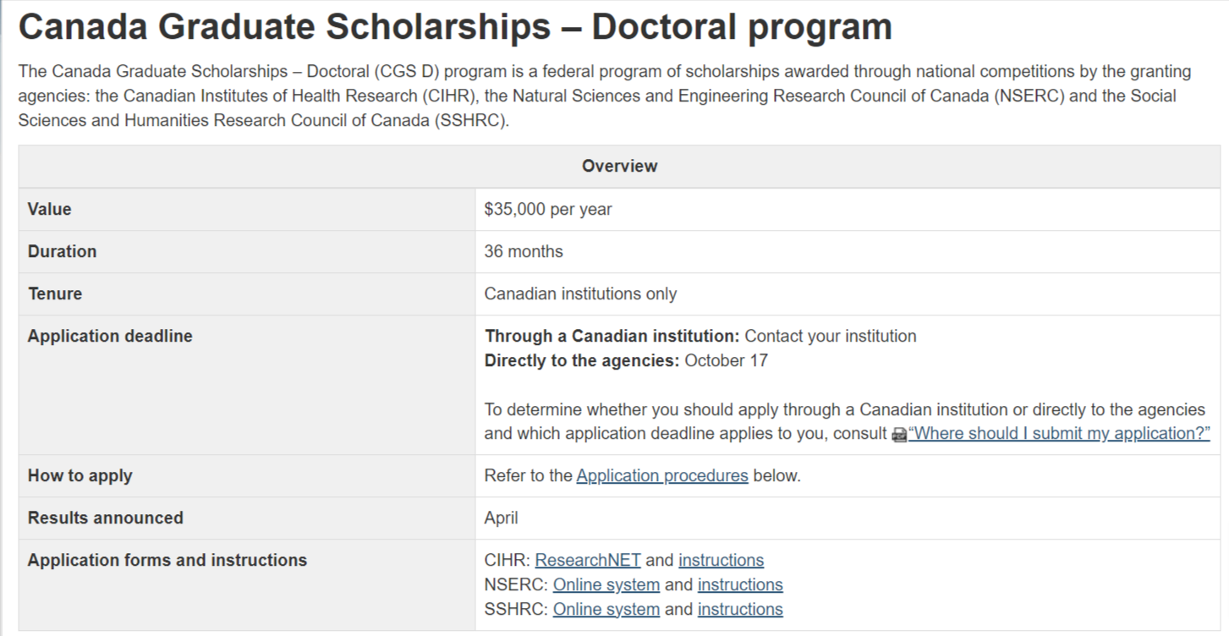
https://www.nserc-crsng.gc.ca/students-etudiants/pg-cs/cgsd-bescd_eng.asp

Slide 23
Eligibility – CGS-D
Be a Canadian citizen, a permanent resident of Canada or a Protected Person under subsection 95(2) of the Immigration and Refugee Protection Act (Canada), as of the application deadline
Have completed no more than 24 months of full-time study in your doctoral program by December 31 of the calendar year of application if previously enrolled in a graduate program
Have completed no more than 36 months of full-time study in your joint program by December 31 of the calendar year of application if enrolled in a joint program; such as, MD/PhD, MA/PhD
Have completed no more than 36 months of full-time study in your doctoral program by December 31 of the calendar year of application if enrolled directly from a bachelor’s to a Ph.D. program (without having completed or enrolled in another graduate program)
You can submit a maximum of one scholarship or fellowship application per academic year to either CIHR, NSERC or SSHRC.
You cannot have already received a doctoral-level scholarship from CIHR, NSERC or SSHRC (does not apply to CIHR Fellowships).
You cannot hold a tenure or tenure-track appointment concurrently with your CGS D award.
https://www.nserc-crsng.gc.ca/students-etudiants/pg-cs/cgsd-bescd_eng.asp

Slide 24
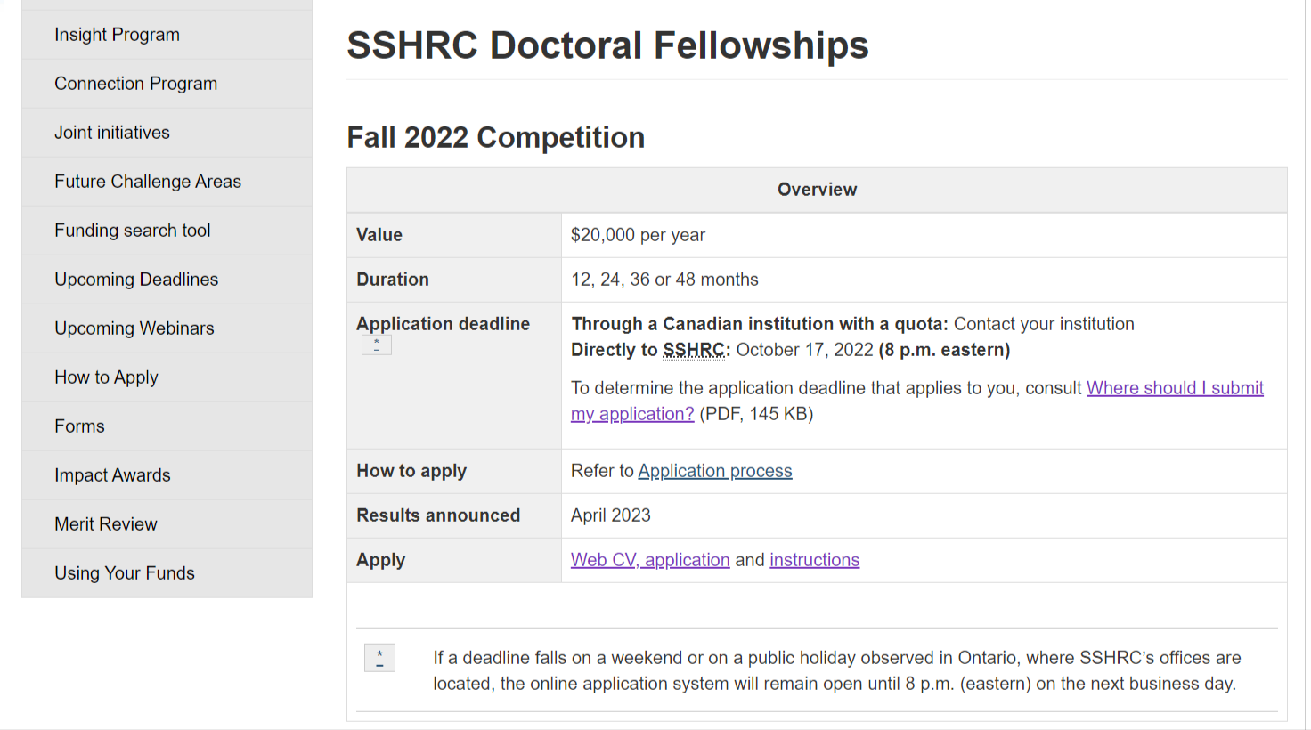
https://www.sshrc-crsh.gc.ca/funding-financement/programs-programmes/fellowships/doctoral-doctorat-eng.aspx

Slide 25
Eligibility – SSHRC DF
Be a Canadian citizen or a permanent resident of Canada or a Protected Person under subsection 95(2) of the Immigration and Refugee Protection Act (Canada), as of the application deadline
Not have already received a doctoral-level scholarship or fellowship from the Canadian Institutes of Health Research (CIHR), the Natural Sciences and Engineering Research Council (NSERC) or SSHRC
Not have submitted more than one scholarship or fellowship application per academic year to either CIHR, NSERC or SSHRC (Should more than one application be submitted, the eligible application submitted first chronologically will be retained; nominations to the Vanier CGS program do not count toward this limit—see SSHRC’s regulations on multiple applications and on holding multiple awards for more information.)
have completed no more than 48 months of full-time study in their doctoral program by December 31 of the calendar year of application.
https://www.sshrc-crsh.gc.ca/funding-financement/programs-programmes/fellowships/doctoral-doctorat-eng.aspx

Slide 26
Evaluation Criteria
Research ability and potential (50%)
quality of research proposal
relevant training
research experience and achievements
quality of contributions
etc…..
Relevant experience and achievements obtained within and beyond academia (50%)
scholarships, awards and distinctions
professional, academic and extracurricular activities
etc…
https://www.nserc-crsng.gc.ca/students-etudiants/pg-cs/cgsd-bescd_eng.asp

Slide 27
SSHRC Program of Study
Clearly state your current level of graduate study
Indicate what stage you are at in your thesis.
Provide the name of your supervisor of doctoral studies, if known
Provide an outline of your thesis proposal including the research question, context, objectives, methodology, and contribution to the advancement of knowledge
Describe what you hope to accomplish during the award tenure (up to 3 years for SSHRC) and what will remain to be done before you obtain your degree
(Somewhat different for those presently at Masters level)

Slide 28
Other Attachments - PhD
Research contributions, relevant experience and activities— maximum one page Part I—Research contributions
Refereed contributions
Other refereed contributions
Non-refereed contributions
Forthcoming contributions
Part II—Applicant’s statement
Relevant experience
Relevant activities
Bibliography and Citations — maximum five pages
https://www.sshrc-crsh.gc.ca/funding-financement/instructions/doctoral/doctoral-eng.aspx#biblio

Slide 29
Other
Transcripts:
Include up-to-date official transcripts of all undergraduate and graduate studies in the application. Retain the paper copy of any uploaded transcripts, as you could be asked to provide it for verification purposes.
For the fall 2022 competition, SSHRC will accept unofficial electronic transcripts if official transcripts are not available.
References:
Enter the family name, given name, and email address of each referee.
The system will automatically generate an email to each person, inviting them to complete a Letter of Appraisal form.
It is your responsibility to ensure that all required application components have been submitted (including all attachments and letters). The system does not accept incomplete applications.

Slide 30
Other Parts of Application
Transcripts
Transcripts must be scanned in black and white, and all transcripts saved as a single PDF file.
You must include one copy, but only one copy, of the legend located on the reverse of each transcript
Up-to-date transcripts of all undergraduate and graduate studies
If you are already registered in your program of study at the time of application, you must submit a transcript for this program, regardless of the number of months completed, to demonstrate registration in the program.
All programs of study listed in the CCV, even if not completed, must be accompanied by an up-to-date transcript

Slide 31
CGS-D – Reference Assessments
2 references
Complete applications must include two letters of appraisal of one page each.
One referee should be very familiar with your research and abilities (i.e., current or previous research supervisor) and the other should be sufficiently familiar with your research and abilities to provide a meaningful commentary.
It is your responsibility to ensure that all required application components have been submitted (including all attachments and letters). The system does not accept incomplete applications.

Slide 32
Presentation Standards
Text must be single-spaced, with no more than six lines per inch.
The acceptable font is Times New Roman (regular, 12-pt.) or any comparable serif font.
Set margins at a minimum of 2 cm (3/4 of an inch) all around.
Use a left-justified, standard page layout.
Include your name in the page header (on every page).
For multipage attachments, number the pages sequentially.
The maximum number of pages permitted is indicated in each section of the application. Pages in excess of the number permitted will be removed.
All attachments must be in PDF format before they can be attached to the electronic application.

Slide 33
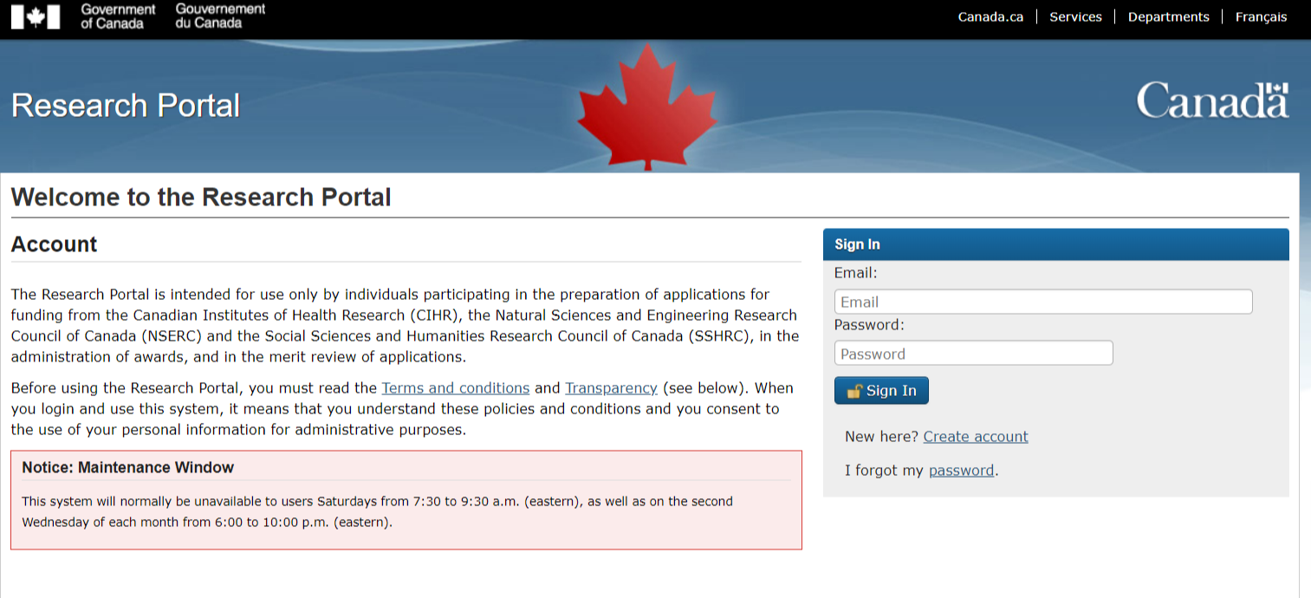
How to Apply
Research Portal
https://portal-portail.nserc-crsng.gc.ca/
Instructions
Masters:
http://www.nserc-crsng.gc.ca/ResearchPortal-PortailDeRecherche/Instructions-Instructions/CGS_M-BESC_M_eng.asp
PhD:
https://www.sshrc-crsh.gc.ca/funding-financement/instructions/doctoral/doctoral-eng.aspx#referees-repondants

Slide 34
Other – Canadian Common CV (CCV)
Canadian Common CV
https://ccv-cvc.ca/indexresearcher-eng.frm
Instructions for completing the CCV and attaching it to your application
http://www.nserc-crsng.gc.ca/Students-Etudiants/CCV_CGSM-CVC_BESCM_eng.asp

Slide 35
If your area of Research is CIHR or NSERC
You will likely not be able to apply to SSHRC
Ineligible For SSHRC Support
clinical education for health care professionals;
psychomotor research and kinesiology;
clinical research (e.g., treatment, prevention or diagnosis of a condition, disorder or disease; testing or evaluating the impact of interventions, medication or medical aids);
therapy (e.g., counselling, interventions, psychotherapy, rehabilitation, speech and occupational therapy, validation/testing of diagnostic tools); and
epidemiology.
CIHR applications are more complicated
Doctoral Research Awards
https://cihr-irsc.gc.ca/e/38887.html
NSERC
Master’s Program
https://www.nserc-crsng.gc.ca/students-etudiants/pg-cs/cgsm-bescm_eng.asp
Doctoral Program
https://www.nserc-crsng.gc.ca/students-etudiants/pg-cs/cgsd-bescd_eng.asp

Slide 36
HELP!!
Binder of successful applications in the Research Office
Ask your supervisor, ask your peers, ask your room-mate… to read your proposal and provide feedback
OGS: Contact Erin Daley, Scholarship Coordinator by EMAIL.

Slide 37
Deadlines:
CGS-M: December 1, 2022
OGS: February 1, 2023, at 4:00 p.m. (EST).
CGS-D: October 17, 2023

Slide 38
Trudeau Doctoral Scholarships

Slide 39
This three-year leadership program is designed to train Engaged Leaders, equipping outstanding doctoral candidates with the skills to translate their ideas into action, for the betterment of their communities, Canada, and the world. Scholars are selected each year and receive leadership training in the context of Brave Spaces, in addition to generous funding for their studies.
Eligibility:
You must be already accepted into or in year one or two of a full-time doctoral program and expected to complete your doctoral studies in 2026 or later.
Your field of study is broadly related to the humanities or human sciences of direct relevance to the future of Canada
Your doctoral work must relate to at least one of the Foundation’s Four Themes: Human Rights and Dignity, Responsible Citizenship, Canada and the World, and People and their Natural Environment.
Be a Canadian citizen studying at a Canadian or foreign institution, or a non-Canadian (permanent resident of Canada or foreign national) enrolled in a doctoral program at a Canadian institution.

Slide 40
Value and Duration:
$40,000 per year for three years to cover tuition and reasonable living expenses; and $20,000 per year for three years, as a research and travel allowance
Deadline:
December 2, 2022, at 5:00 p.m. EST
Information:
https://www.trudeaufoundation.ca/scholarship
https://grad.uwo.ca/finances/external_funding/trudeau.html
Step-by-Step Guide to Applying
https://www.trudeaufoundation.ca/become-scholar#tab-step-by-step-guide-to-applying

Slide 41
Postdoctoral fellowships
Primarily funded through grants. Ask your (future) supervisor to apply or, find a supervisor with funding

Slide 42
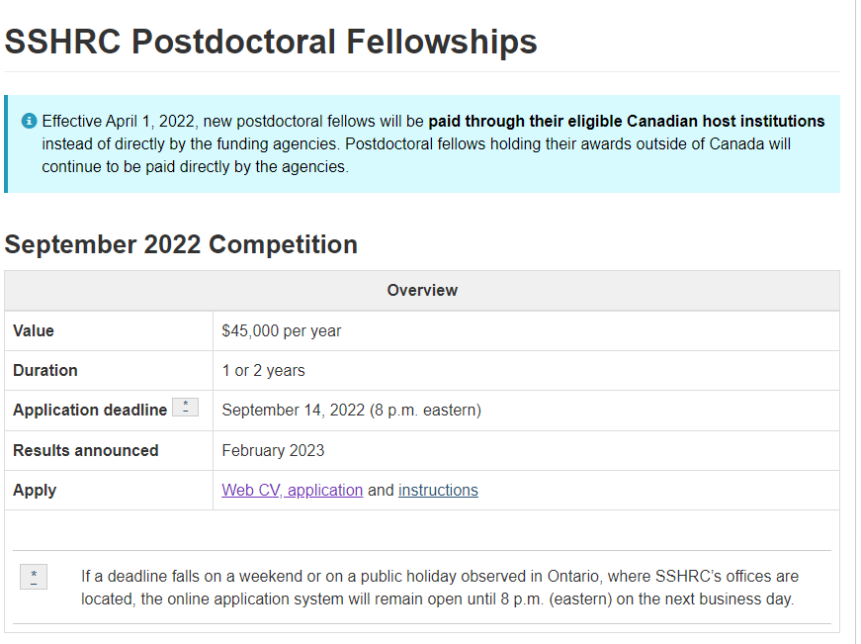
https://www.sshrc-crsh.gc.ca/funding-financement/programs-programmes/fellowships/postdoctoral-postdoctorale-eng.aspx

Slide 43
Internal Conference Grant

Slide 44
Purpose: To support full-time Ph.D. and MA students in their research by providing the opportunity to attend conferences to present their research work and to benefit from interactions with other researchers. Amount: Maximum $3000 per student per fiscal year (May 1-April 30) to attend one or more conferences during the fiscal year. Deadline: March 1 and October 1 by 4 pm EST Submission: Via email to edu-researchoffice@uwo.ca Application & More Information: Online at https://www.edu.uwo.ca/research/documents/MA-PhD_Conference_Travel-ApplicationForm-Spring2022.pdf
Faculty of Education PhD and MA – Graduate Student Internal Conference Travel Grant

Slide 45
Purpose: To support full-time Ph.D. and MA students in their research by providing the opportunity to attend conferences to present their research work and to benefit from interactions with other researchers. Amount: Maximum $1500 per student per fiscal year (May 1-April 30) to attend one or more conferences during the fiscal year. Deadline: March 1 and October 1 by 4 pm EST Submission: Via email to edu-researchoffice@uwo.ca Application & More Information: Online at https://www.edu.uwo.ca/research/documents/EdD_Conference_Travel-ApplicationForm-Spring2022.pdf
Faculty of Education Ed.D. – Graduate Student Internal Conference Travel Grant

Slide 46
Graduate Program Funding:
Western Graduate Research Scholarship (WGRS)
Graduate Teaching Assistantship (GTA)
Graduate Student Assistantship
Graduate Fellowship
Donor-Funded Awards
Donor-Funded Awards Search
Alzheimer Society London and Middlesex
Global Opportunities Award
John and Catherine Kelly Bursary
https://grad.uwo.ca/finances/western_funding/index.html

Slide 47
Strategic Scholarship Competition Support
Provincial Scholarship Competitions
Ontario Graduate Scholarships (OGS) and QEII Graduate Scholarships in Science and Technology (QEIIGSST)
Ontario Trillium Scholarships (OTS)
Autism Scholars Awards
John Charles Polanyi Prizes
Ontario Women's Health Scholars Awards
CMHA Ontario Doctoral Fellowships in Mental Health and Addictions Services Research
https://grad.uwo.ca/finances/external_funding/index.html

Slide 48
National Scholarship Competitions
Canada Graduate Scholarships - Master's
CIHR Doctoral Research Awards
NSERC Doctoral Research Awards
SSHRC Doctoral Research Awards
Vanier Canada Graduate Scholarships
Trudeau Doctoral Scholarships
CGS-Michael Smith Foreign Study Supplements
Governor General's Gold Medals
Richard J. Schmeelk Canada Fellowships
Rhodes Scholarships
Canada's Distinguished Dissertation Awards
American Distinguished Dissertation Awards
McCall MacBain Scholarships
https://grad.uwo.ca/finances/external_funding/index.html

Slide 49
International Funding Opportunities
International Student Awards
Ontario Graduate Scholarships (OGS)
Ontario Trillium Scholarships (OTS)
Trudeau Doctoral Scholarships
Vanier Canada Graduate Scholarships
International Sponsorship and Partnership Programs
CGS-Michael Smith Foreign Study Supplements
China Scholarship Council
Libya North-American Scholarship Program
Egypt Cultural and Educational Bureau
Mitacs Globalink Research Awards
Organization of American States Program
Rhodes Scholarships
Russia - Global Education Program
Saudi Arabia King Abdullah Scholarship Program
Vietnam International Education Development Program
https://grad.uwo.ca/finances/index.htm

Slide 50
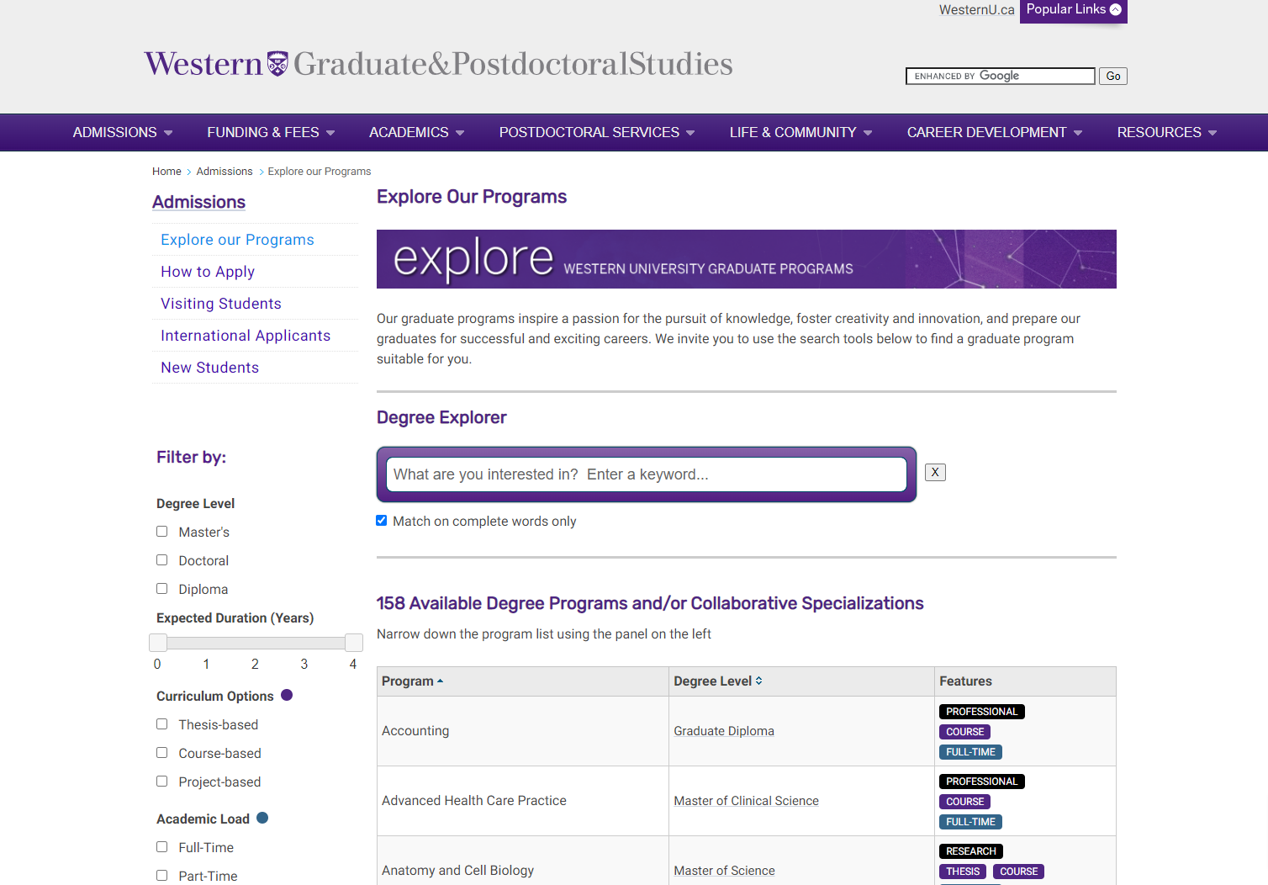
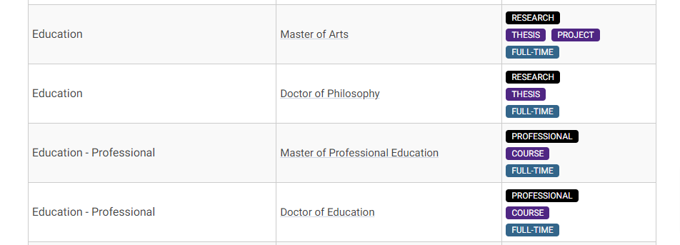
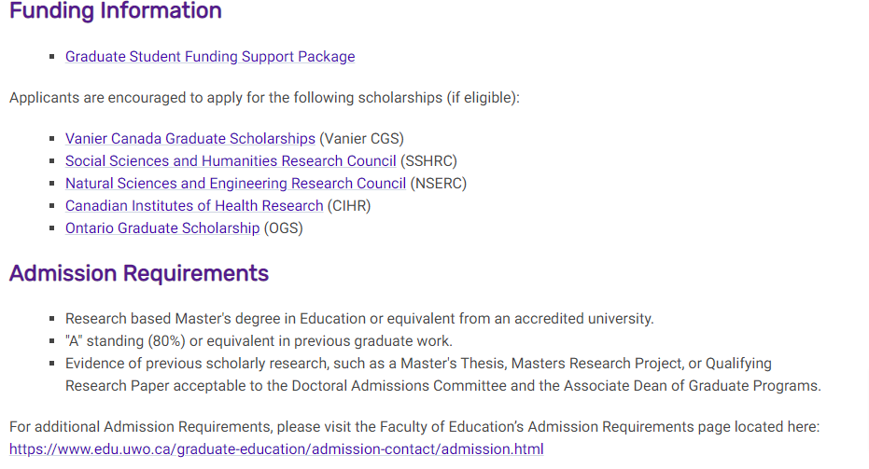
https://grad.uwo.ca/admissions/programs/index.cfm

Slide 51
Contacts

Slide 52
ROLES
Graduate Office (1131)
Research Office (1161)
Eligibility (Grades)
OGS applications questions and assistance
To see successful applications from Graduate Students in Education
Funding for conference travel
Discussions for SSHRC / NSERC / CIHR eligibility

Slide 53
CONTACTS FOR ASSISTANCE Associate Dean Research: Nicole Neil nneil@uwo.ca x84761 Research Officer: Malihe Mehdizadeh Allaf mmehdiza@uwo.ca x88561 Research Administrative Assistant Connor Hassan chassan@uwo.ca x88068 Grad Studies – Faculty of Education Contacts SGPS (Grad Studies) Western Contacts 519-661-2102

Slide 55
Additional slides: How to write any grant

Slide 56
Application Example (Canada Foundation for Innovation – Leaders’ Opportunity Fund)

Slide 57
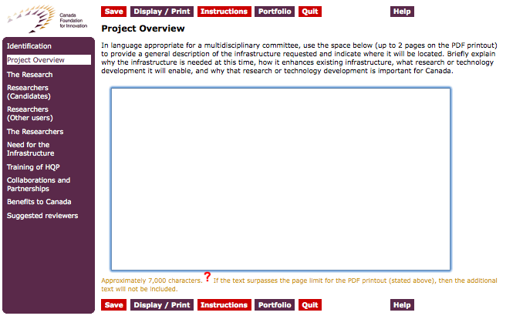
The guidelines for the Overview section from the on-line version of the application forms:

Slide 58
Example of the paper copy of this same Project Overview (Summary) section at the next slide.

Slide 59
Do they match? No. Be sure to check the application instructions and the paper copies of the application.

Slide 60
How do you write the Overview/Summary/first section of a grant? Right at the outset (whether it is requested or not): A. Set the stage – 1 or 2 sentences (high-level background information) B. Give the (i) objectives, (ii) significance and outcomes and (iii) impact of your intended research Then go on to talk about: C. The research itself / the criteria the application materials request that you respond to. The CIHR Guidebook for New Investigators gives great advice about how to write any grant. In particular, under “The Layout for the Summary Page,” there are useful tips for how to write the very important first section of any grant (usually called the “Summary” or “overview” section).
Notes:
i. Objectives: We plan to research / build this type of team / do x, y, z.
ii. Significance and outcomes: Doing the activities named in i. will lead to e.g. publications / a trans-continental team / a new way for scholars or the public to understand something you name AND this is important because…
iii. The specific impact upon e.g. the discipline / Canadian society / a named aspect of the economy / policy will be…

Slide 61
What information are you being asked to provide? (answer all questions!)

Slide 62
Example Overview/Summary criteria text:

Slide 63
When writing application sections, you should break criteria sections out into separate questions and be sure that you have responded to each and every one. The block question/criteria from the previous slide is asking six questions: 1. Give a general description of Infrastructure requested 2. Where will it be located? 3. Why is it needed at this time? 4. How does it enhance current infrastructure. 5. What research (and/or technology development) will it enable? 6. Why is this research (and/or this technology development) important for Canada? 7. Note that you are not asked provide elements A (set the stage) and B (i. objectives, ii. significance and outcomes, iii. impact) from slide 12 above in this application’s first section. Do be sure that you have addressed these two elements none-the-less in the first full section – even if briefly before you go on to respond to the criteria.

Slide 64
The CIHR Guidebook for New Investigators

Slide 65
The CIHR Guidebook for New Investigators http://www.cihr-irsc.gc.ca/e/27491.html “Advice on Applying for a Grant, Writing Papers, Setting up a Research Team and Managing Your Time” A very useful guide regardless of your discipline. You need not be working in health – all of this applies to new investigators in SSHRC and NSERC disciplines as well. This is the best grant writing guide I have ever come across

